Slide 1


Slide 2

Snell Standards and
Research for Better Protection
Hong Zhang
IRETS/MSF
August 26-28, 2019
Columbus, OH

Slide 3
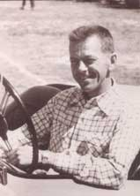
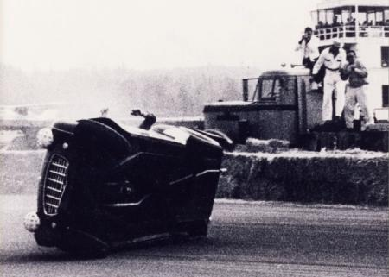
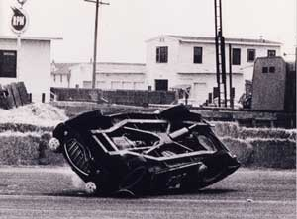
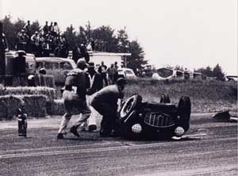
Beginnings
Amateur Racer William “Pete” Snell
Rollover Crash in Arcata, California,
  August 6, 1956
Pete died of head injuries
  Sustained in a then state-of-the-art helmet
Notes:
William “Pete” Snell died of head injuries received in an amateur racing crash in 1956. He had been wearing what was then a state of the art helmet but which failed to prevent fatal head injuries in what was otherwise said to be a survivable crash.

Slide 4
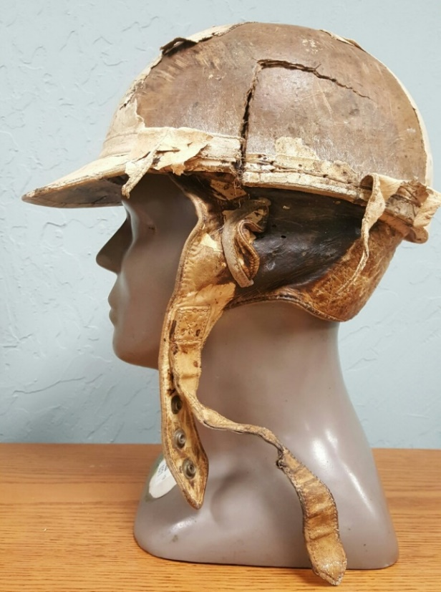
Helmet in 1950s

Slide 5
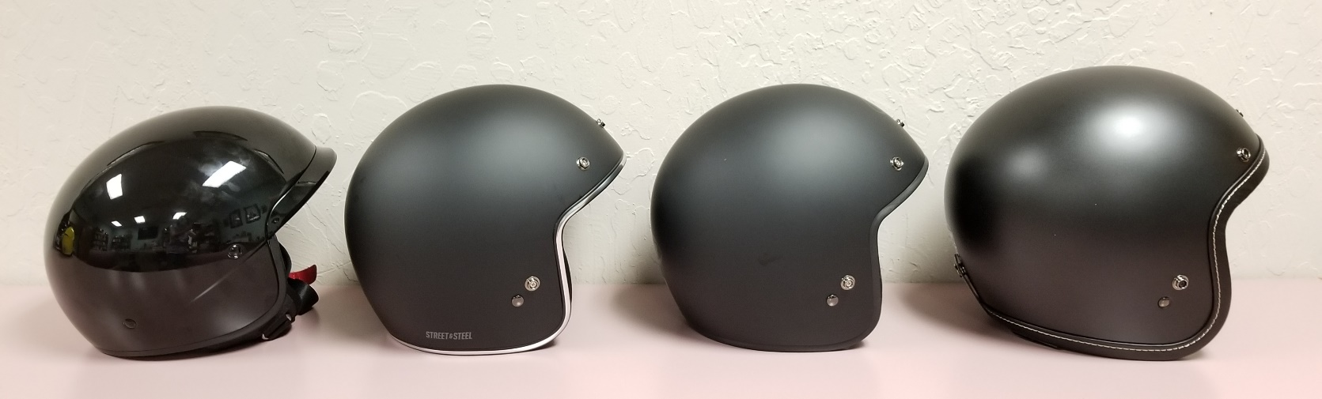
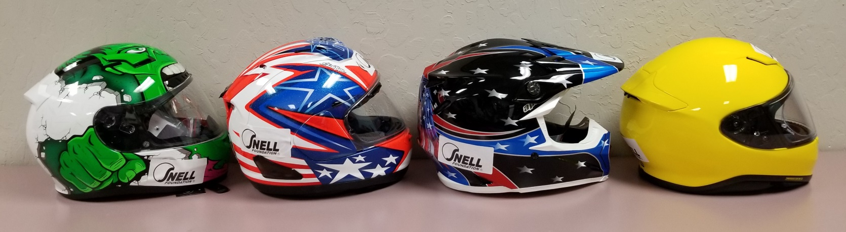
How to Choose among
Today’s Motorcycle Helmets?

Slide 6

Snell Motorcycle
Helmet Standards

Slide 7
Effectiveness of Standards
Standards = Documents
Effectiveness of standards depend on
* Strict and independent certification
* Enforceable compliance
* Experience and competence
Testing and More Testing

Slide 8
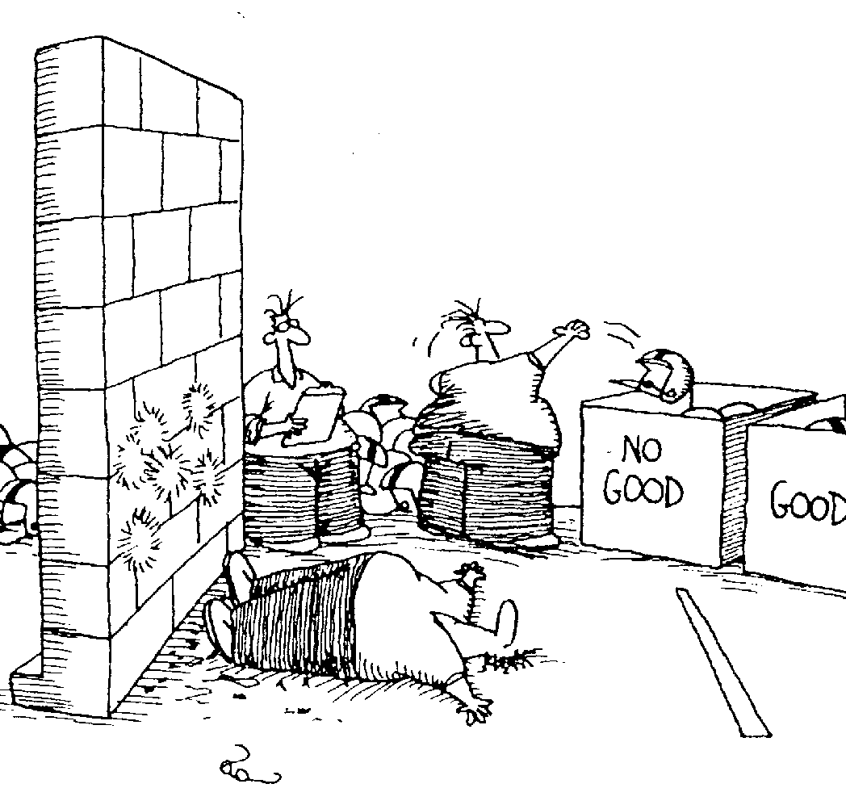
Not how Snell tests helmet

Slide 9
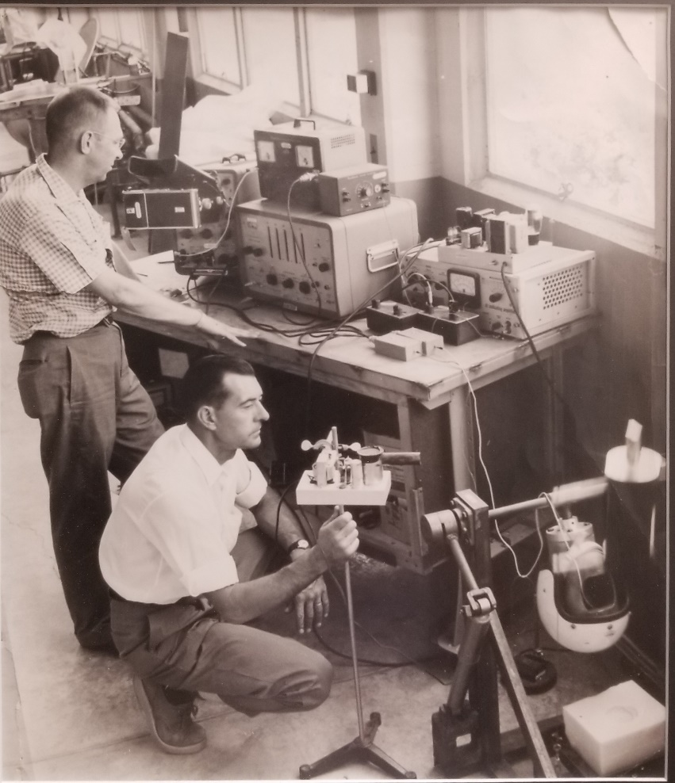
Oldest Snell Testing Photo

Slide 10
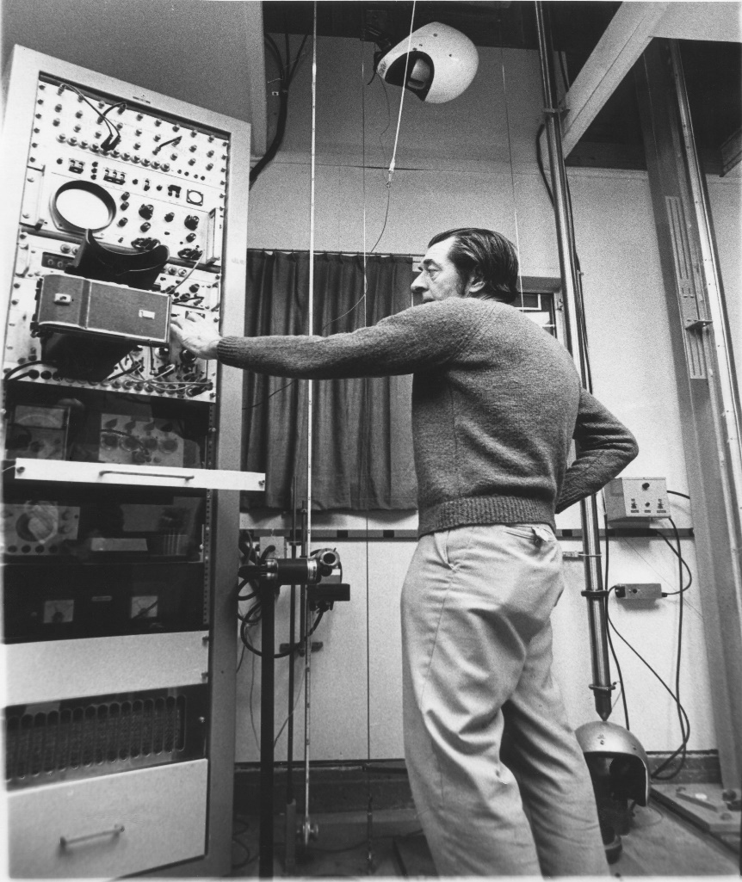
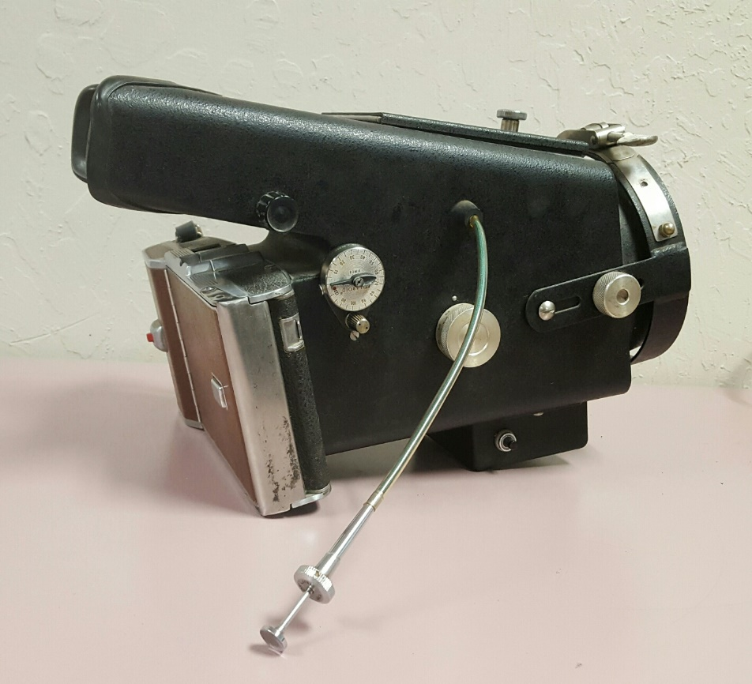
Old Oscilloscope Early 1960s

Slide 11
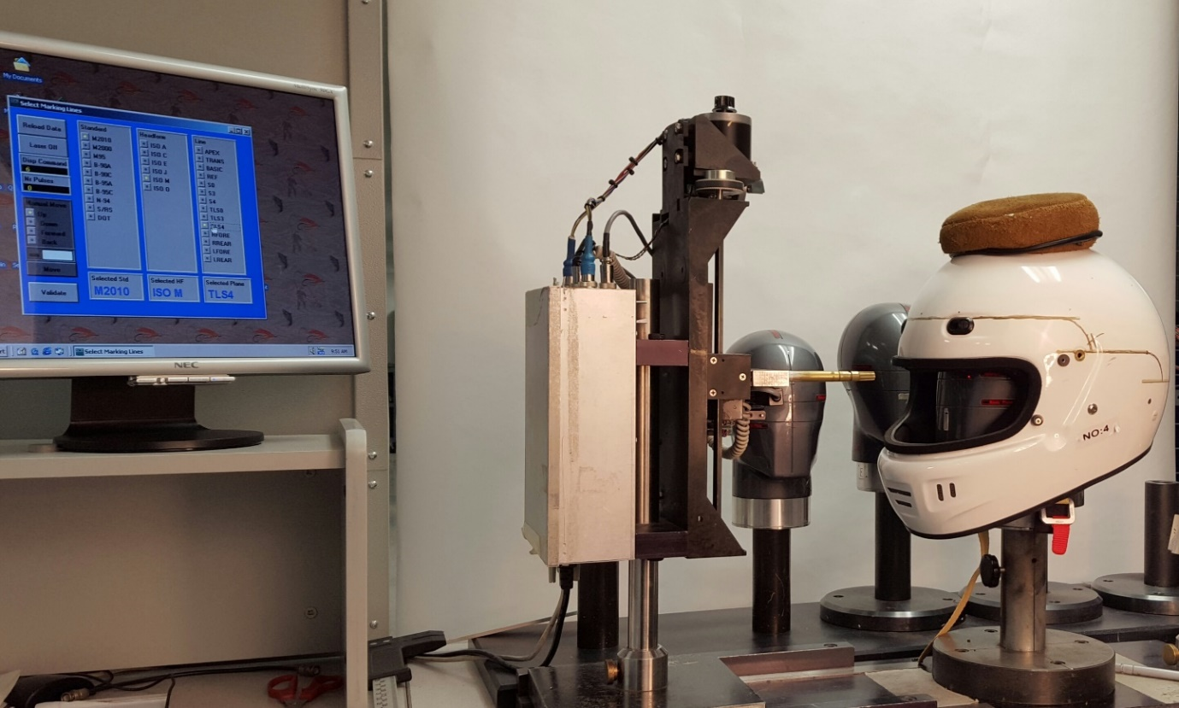
Snell Test Lab Today

Slide 12
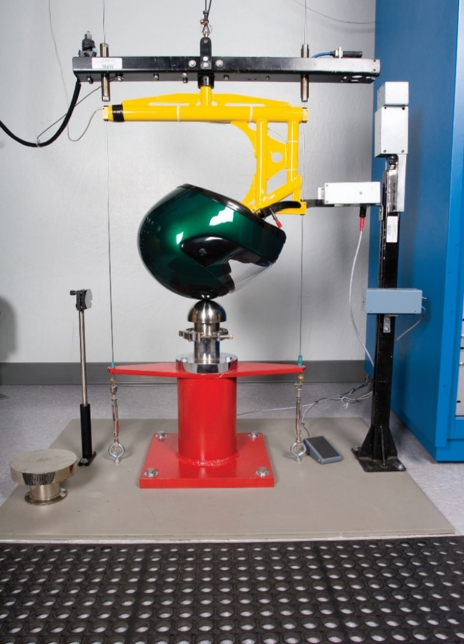
Snell Impact Test

Slide 13
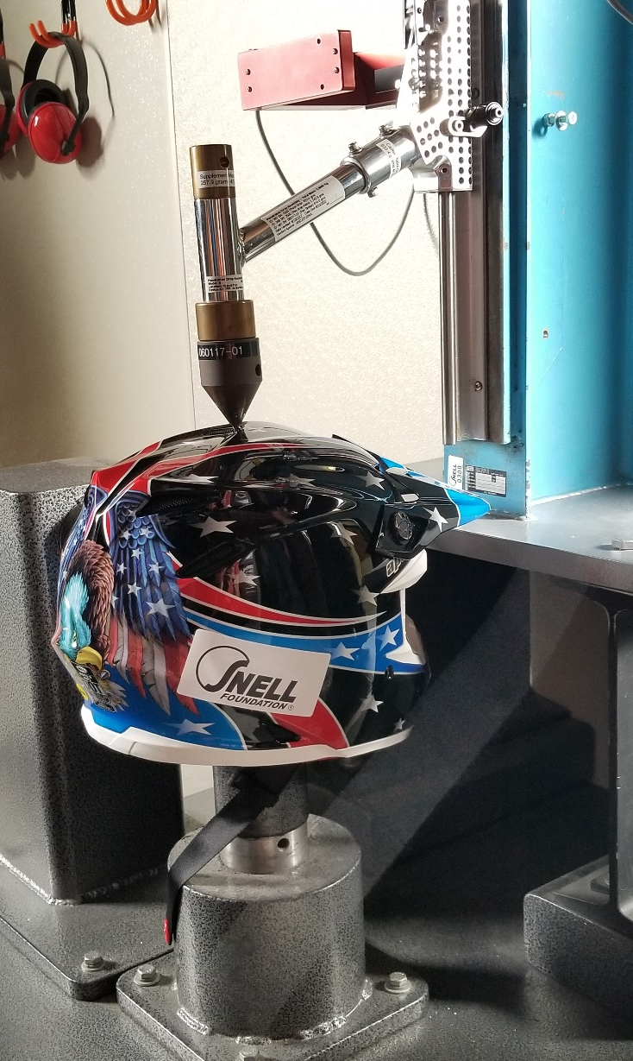
Snell Penetration Test

Slide 14
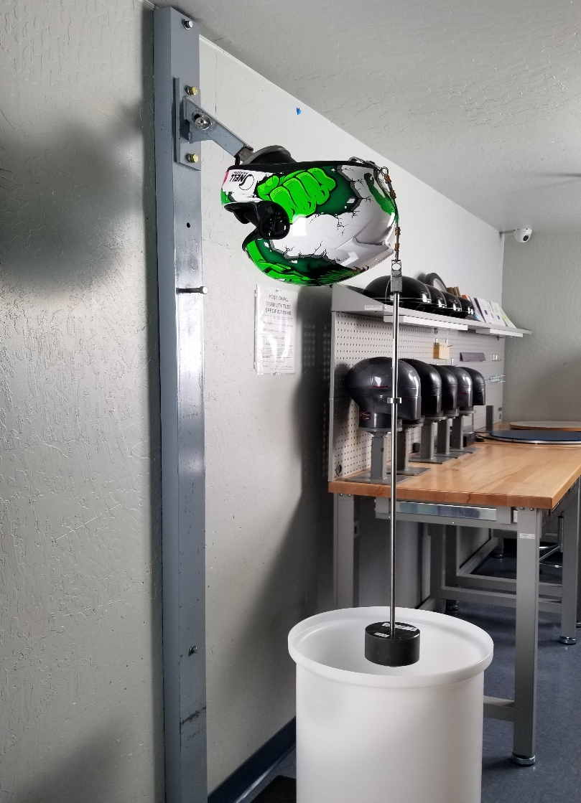
Roll-off Test

Slide 15
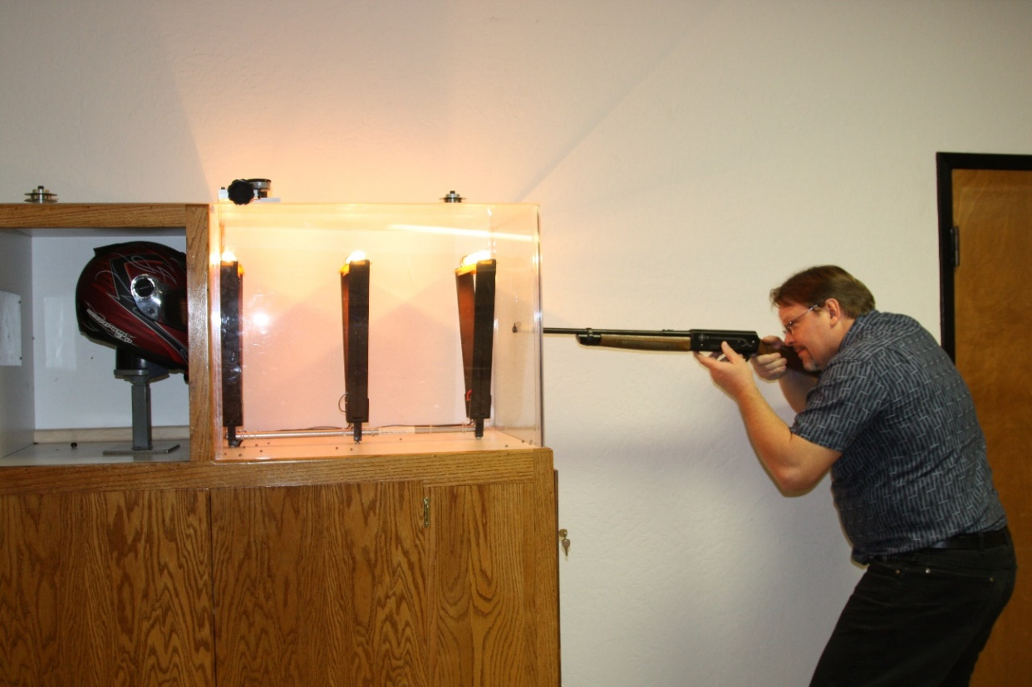
Snell Face Shield Test

Slide 16
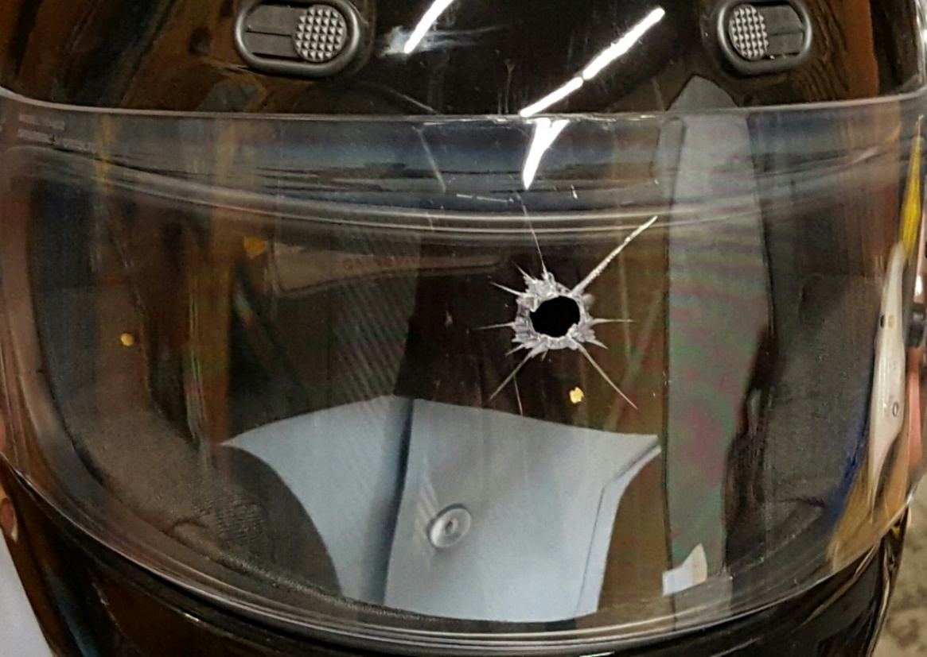
Some fail tests.

Slide 17
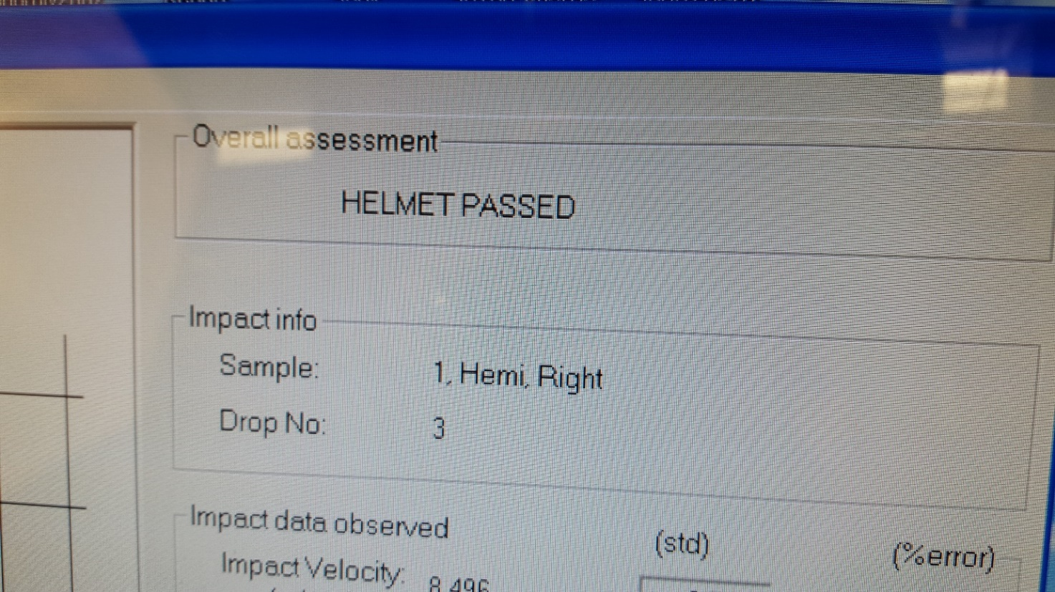
Some pass tests.

Slide 18
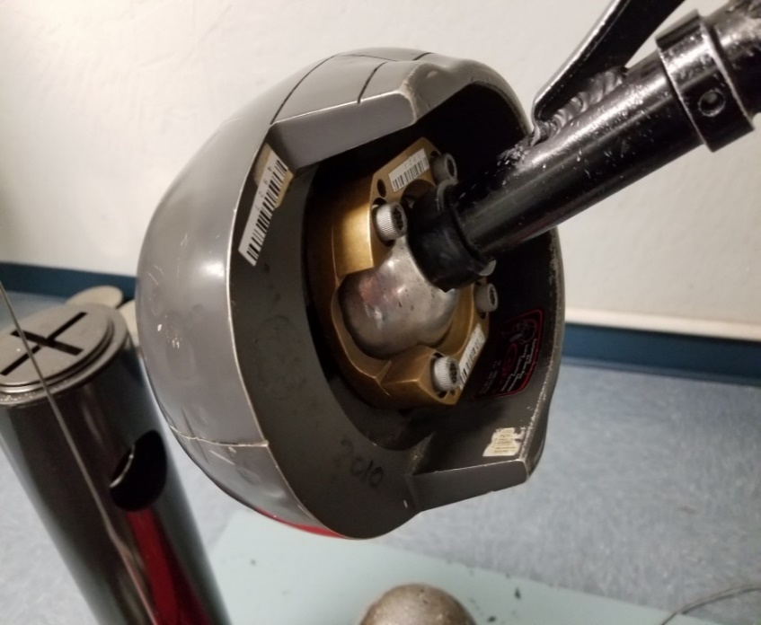
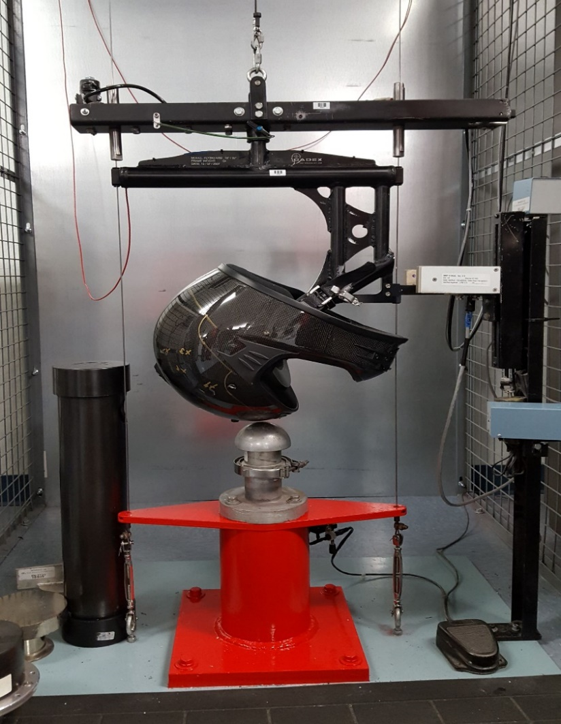
Scientifically Valid
& Repeatable Test

Slide 19
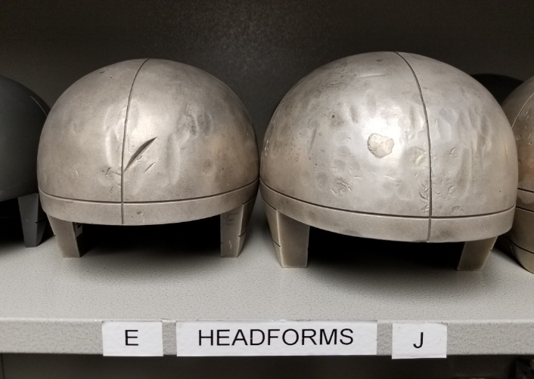
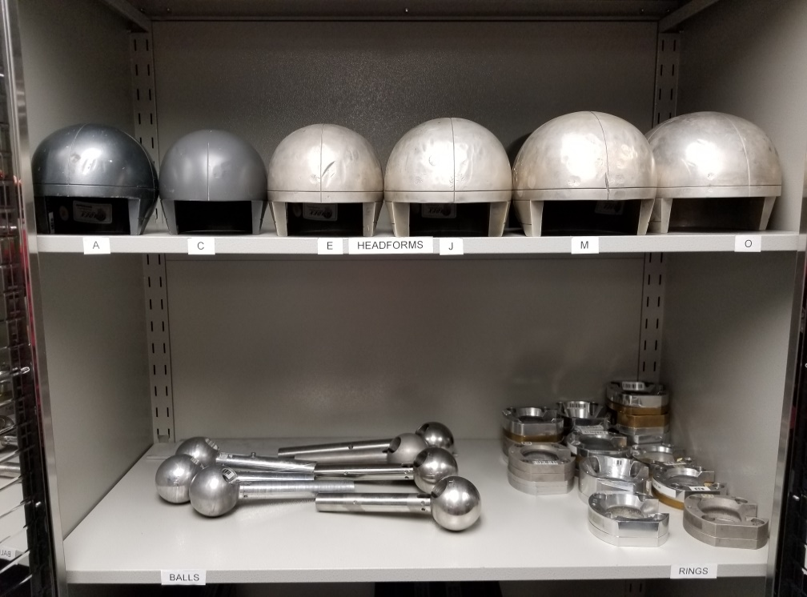
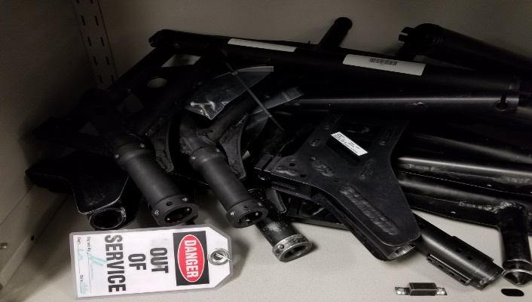
Experience and Expertise

Slide 20
Snell Certification Program
Tough Standard Requirements
  To ensure best protection available
Certification
  To determine Worthy Helmets
Random Sample Testing
  To assure compliance of helmets in markets

Slide 21
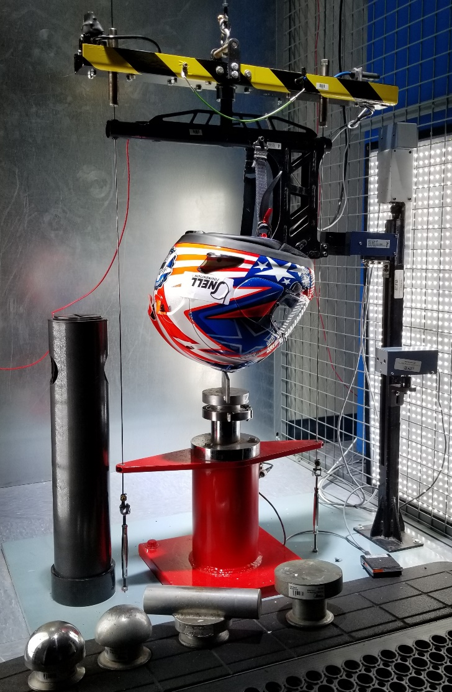
Snell Certification/RST Testing

Slide 22
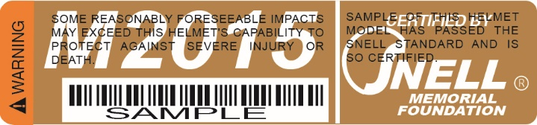
Snell – Most Stringent Standard

Slide 23
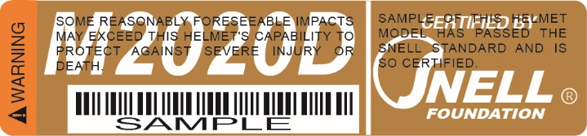
Snell Updates Standards Every 5 Years
M2020 Standard Effective Oct. 1, 2019

Slide 24
Newer Helmets and
Greater Protection
The effectiveness of helmet has increased from 29% between 1982-1987 to 37% between 1993-2002.(NHTSA reports)
Tougher Snell Standards
DOT Standard Unchanged
Better Designs and Materials

Slide 25
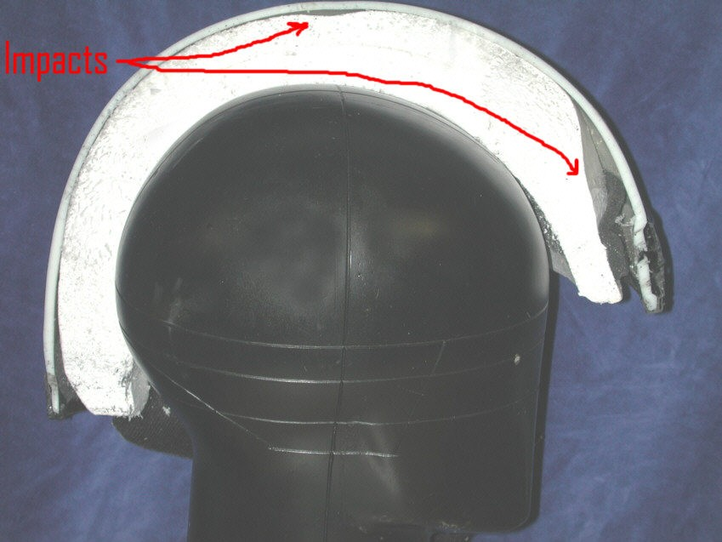
Shell Spreads the Load.
Liner Foam = More Braking Time
Notes:
This is an example of what impact can do. This is a tested helmet which was sawn in half. You can see what test impacts have done in the front. The shell has recovered but the stiff liner has been permanently crushed. It has actually recovered some of it’s thickness. During the impacts, it was squeezed much thinner. Snell helmets need every bit of their wall thickness to pass the tests. Of course, a smaller hit wouldn’t require as thick a liner but if that thinner walled helmet was to get a major hit, once the liner was used up the rest of the damage would go to destroying our test head form; or some rider’s head.

Slide 26
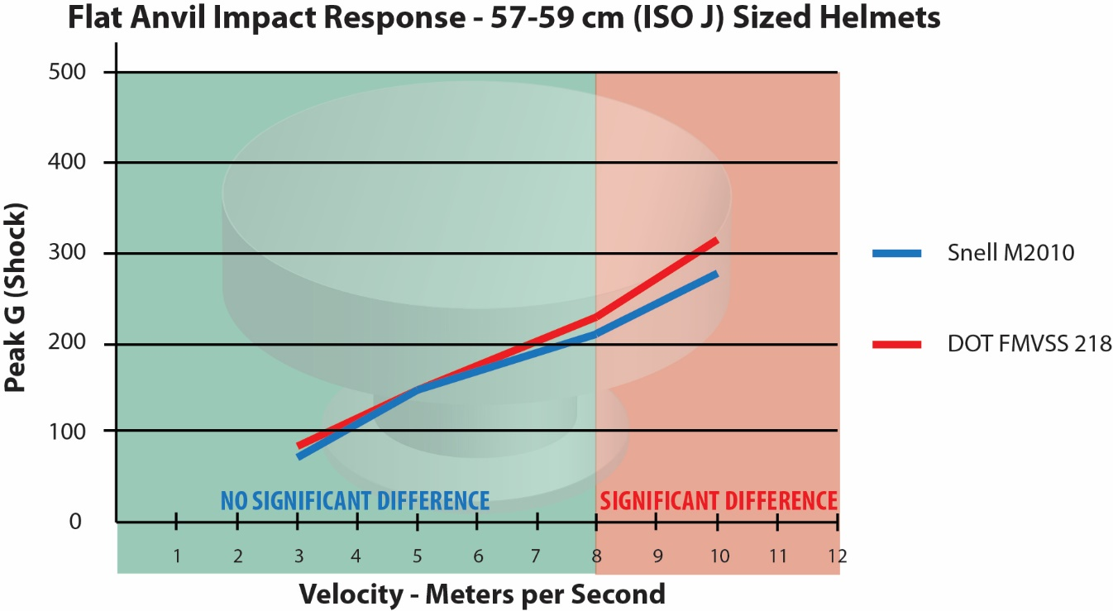
Research Snell vs DOT

Slide 27
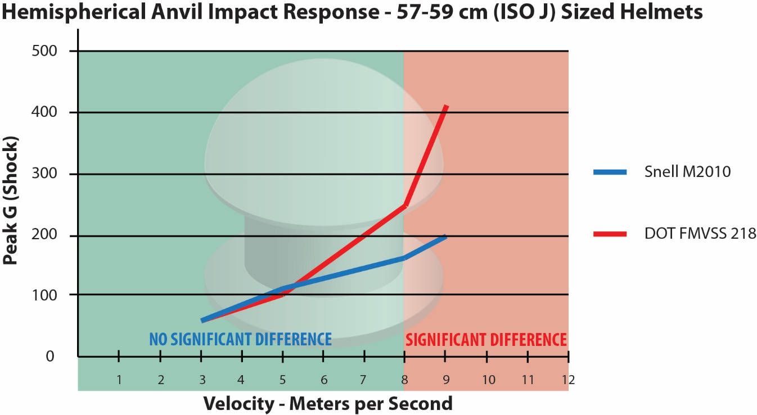
Snell Protects/DOT Bottoms Out

Slide 28
Fact Check
Misinformation that Snell helmets are only for racers.
DOT is NOT all you need.
Snell helmets are NOT too hard.
    Snell & DOT protect the same in minor impacts.
    Snell continues to protect at higher levels long after DOT protection fails.

Slide 29
International Conference of Biomechanics Research (IRCOBI)
September 2015 in Lyon, France
Snell Presents Peer Reviewed Research Paper
Low Energy Impact Comparison Study
Snell and NOCSAE Sponsor a Seminar on Test Method for Angular Acceleration

Slide 30
Three Helmet Standards (US)
ECE and DOT (FMVSS 218)
  Mandatory – minimum impact protection requirement
  DOT Self-certified /ECE Not as protective
    Manufacturers arrange “reasonable” testing
    Claim DOT certification for their own products
Snell M2015
  Voluntary – premium impact protection capability
  Snell certified
    Snell does pre-market and in-market testing
    Manufacturers are bound by contract

Slide 31
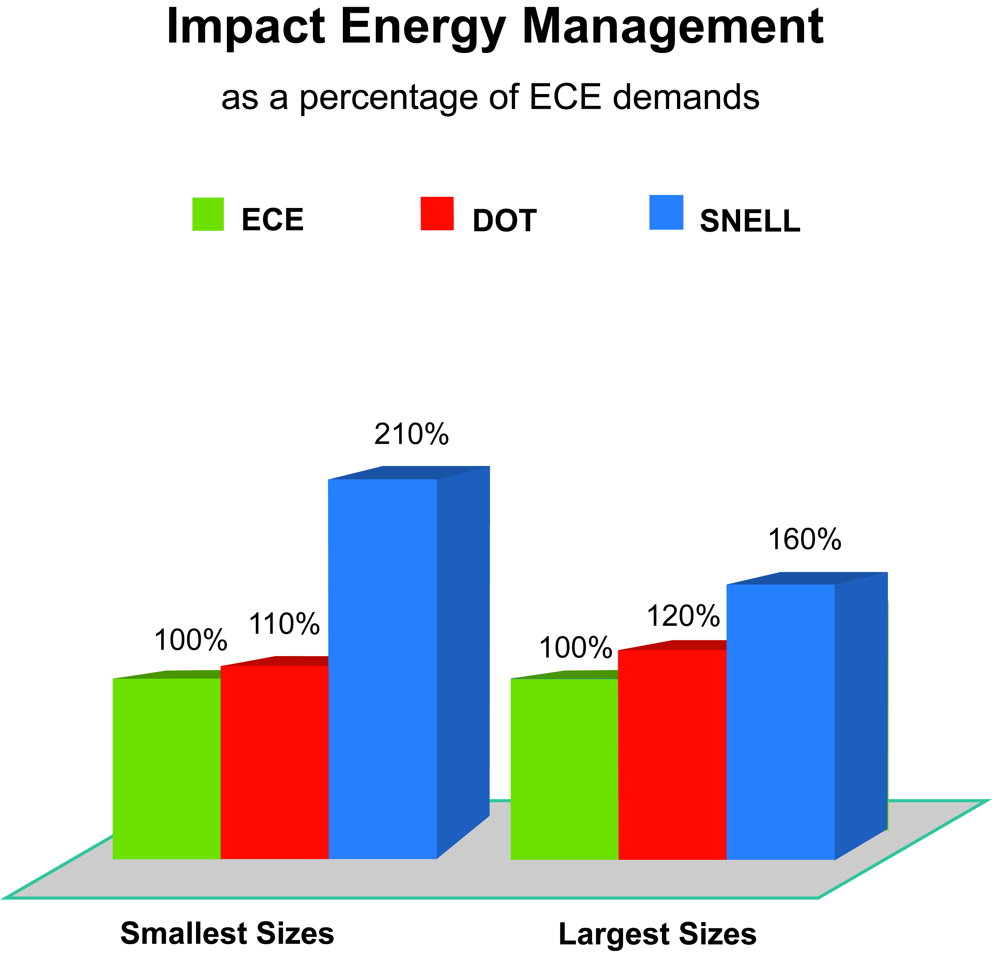

Slide 32
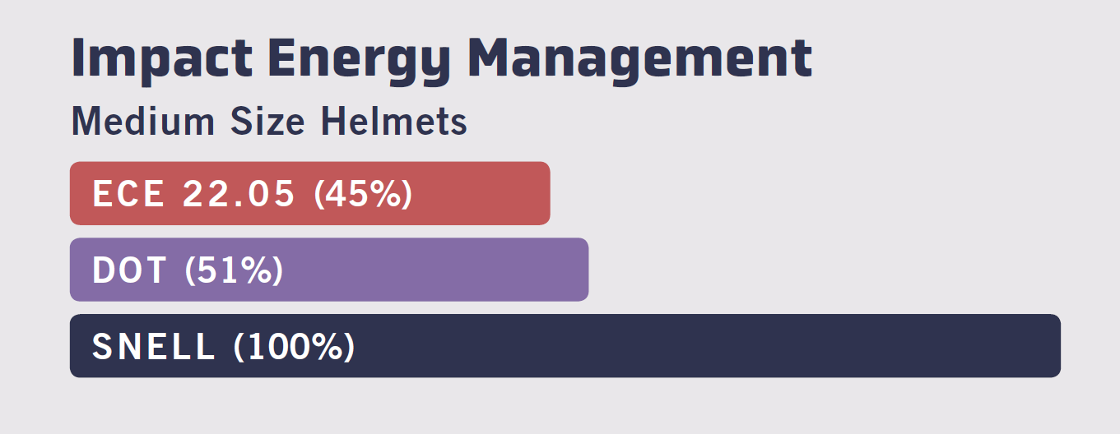
Snell Means Premium Protection.
DOT and ECE are Minimum Requirement.

Slide 33
Motorcycle Helmet Effectiveness
NHTSA estimates that helmet usage leads to:
37% reduction of crash fatality
67% prevention of brain injuries

Slide 34
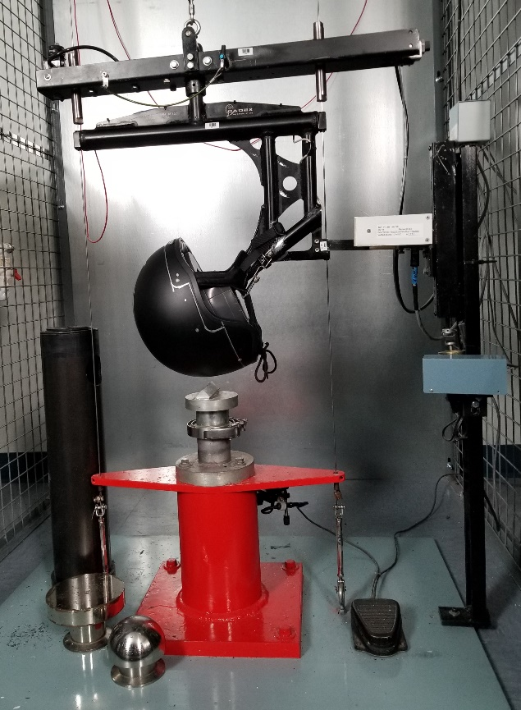
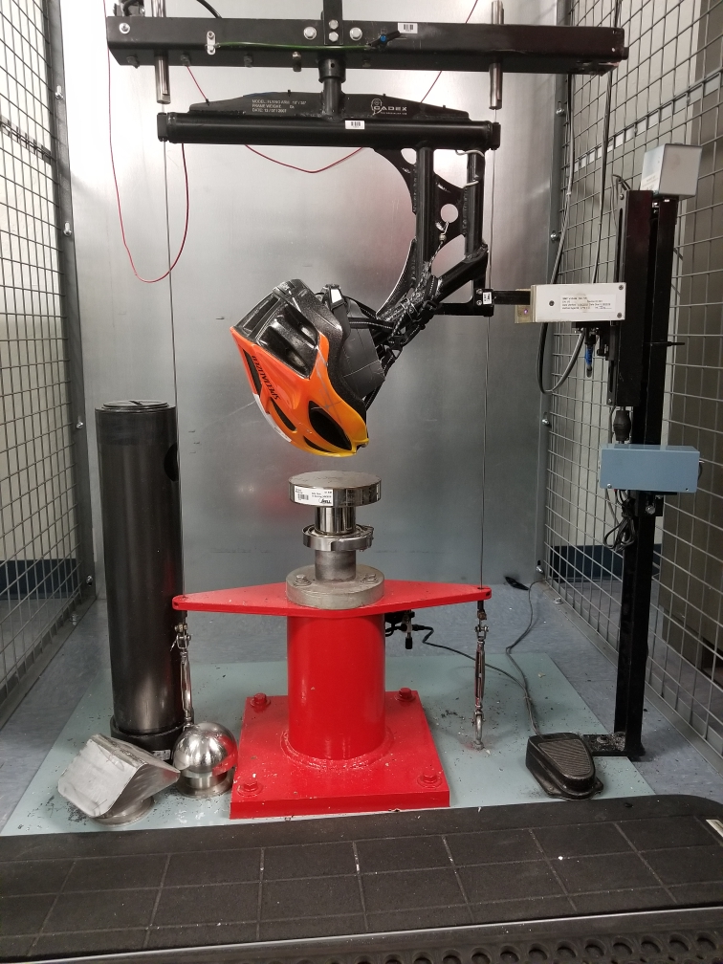
Other Snell Standards

Slide 35
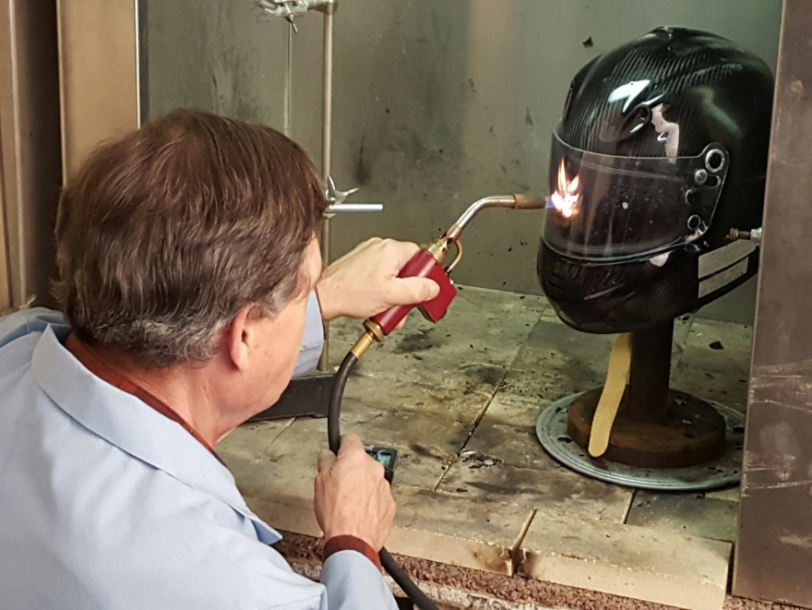
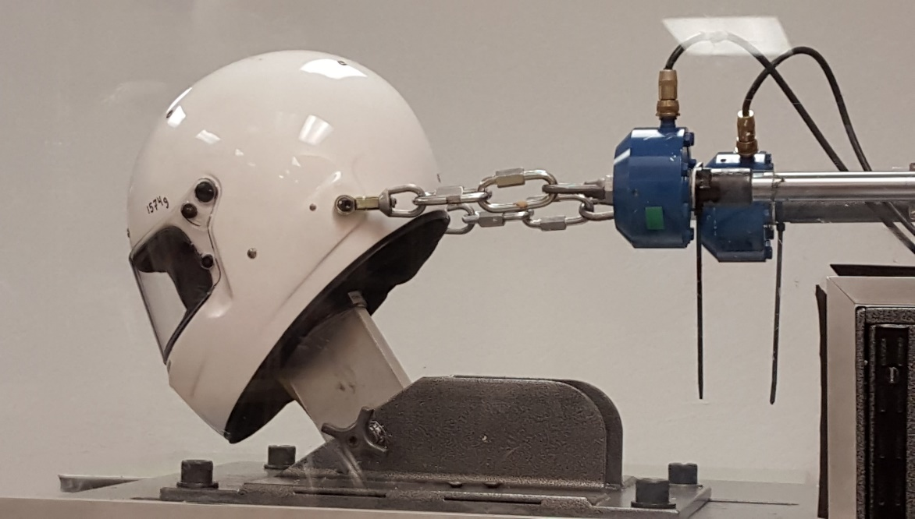
NASCAR & INDY 500

Slide 36
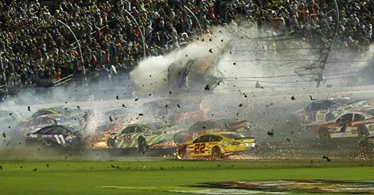
Austin Dillon Walking Away from
2015 Crash NASCAR Daytona Finish

Slide 37
Helmet Fit Research
Well-fitted helmets protect better.
Dr. Amy McIntosh reported in 2012 that children with help fitting a helmet had concussions reduced by 41%.

Slide 38
How Helmets Work
Space
Time
Cartoon Videos on YouTube.com

Slide 39
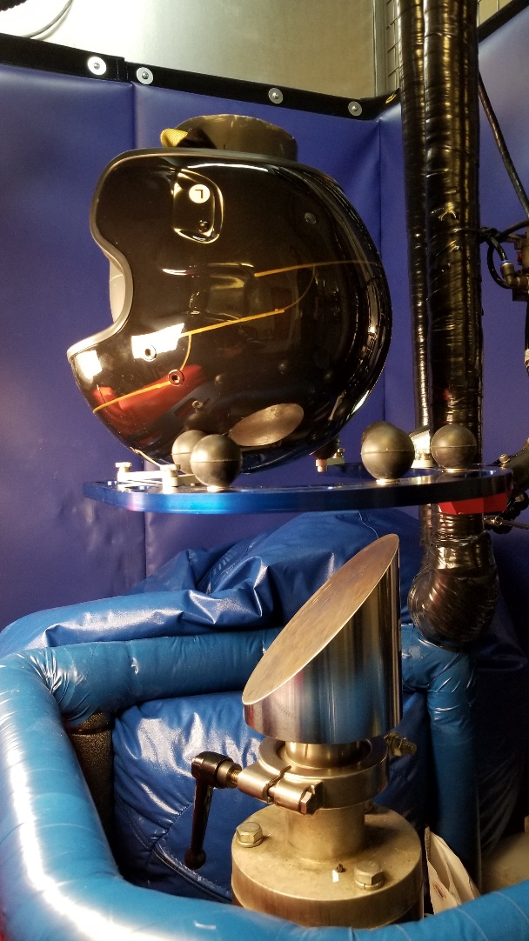
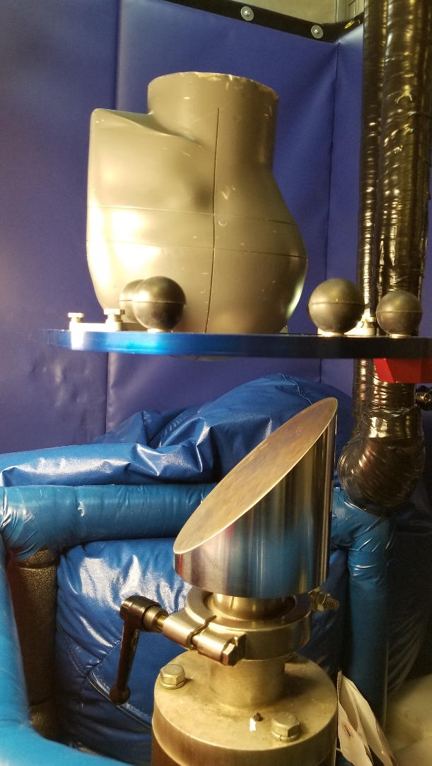
Wireless Head Form for
Rotational Impact Test

Slide 40
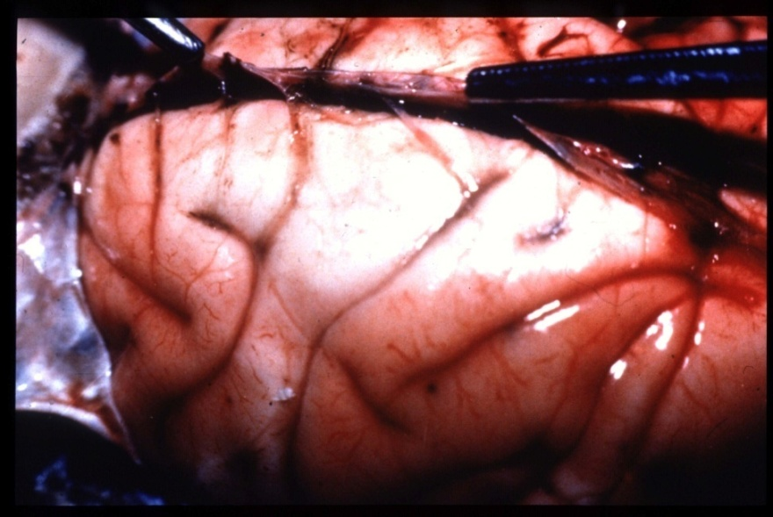
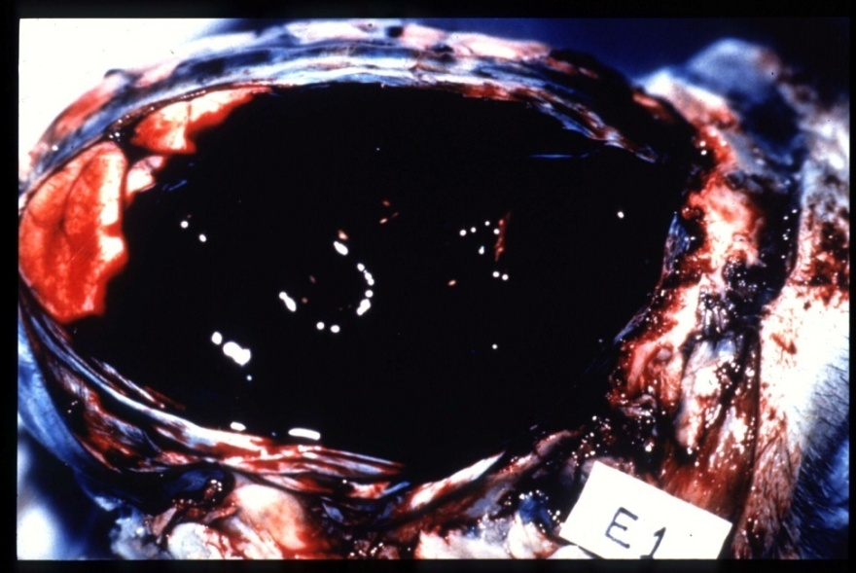
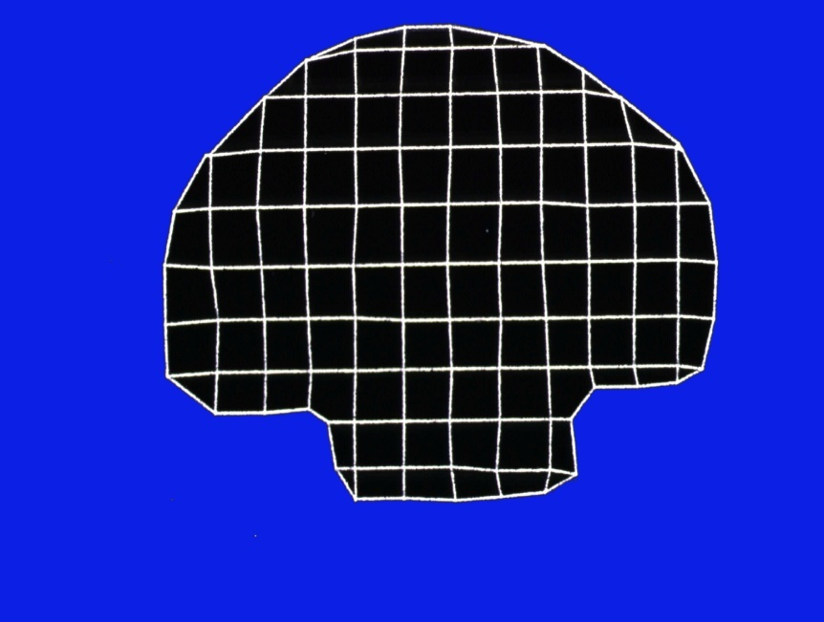
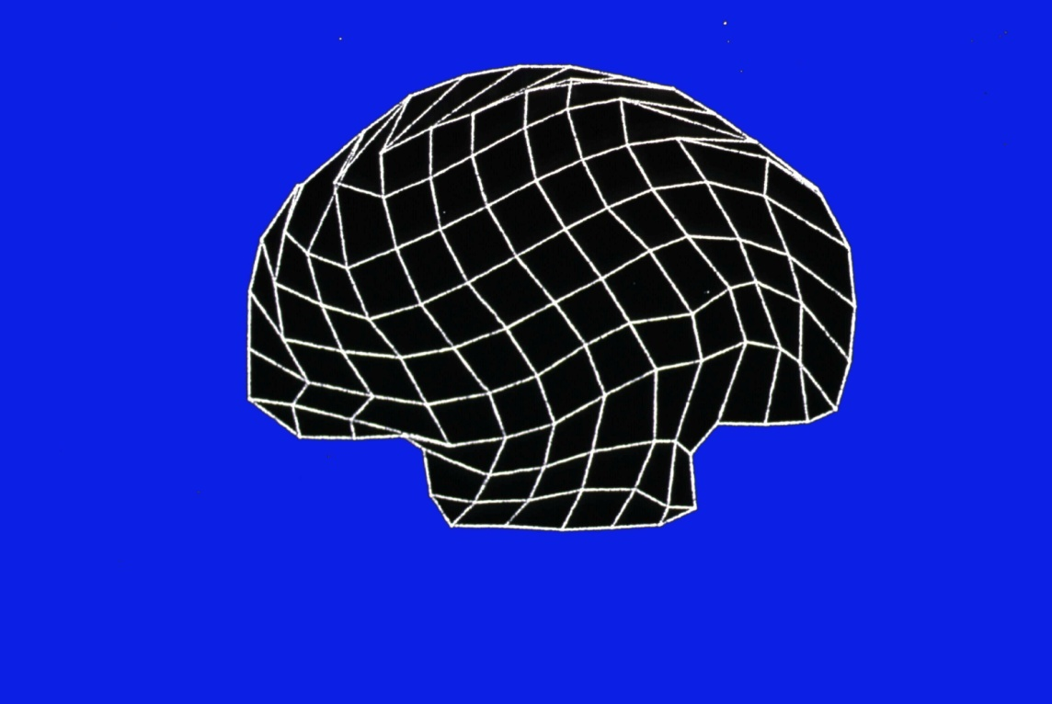
Bridging Vein Rupture

Slide 41
Shell Spreads the Load.
Liner Foam = More Braking Time
Notes:
This is an example of what impact can do. This is a tested helmet which was sawn in half. You can see what test impacts have done in the front. The shell has recovered but the stiff liner has been permanently crushed. It has actually recovered some of it’s thickness. During the impacts, it was squeezed much thinner. Snell helmets need every bit of their wall thickness to pass the tests. Of course, a smaller hit wouldn’t require as thick a liner but if that thinner walled helmet was to get a major hit, once the liner was used up the rest of the damage would go to destroying our test head form; or some rider’s head.

Slide 42
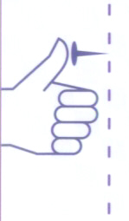
Physics in a Thumb Tack

Slide 43
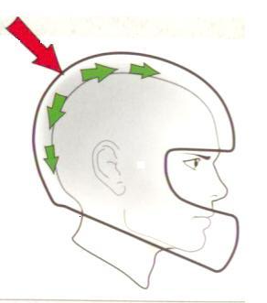
Hard Shell /Spread the Force

Slide 44
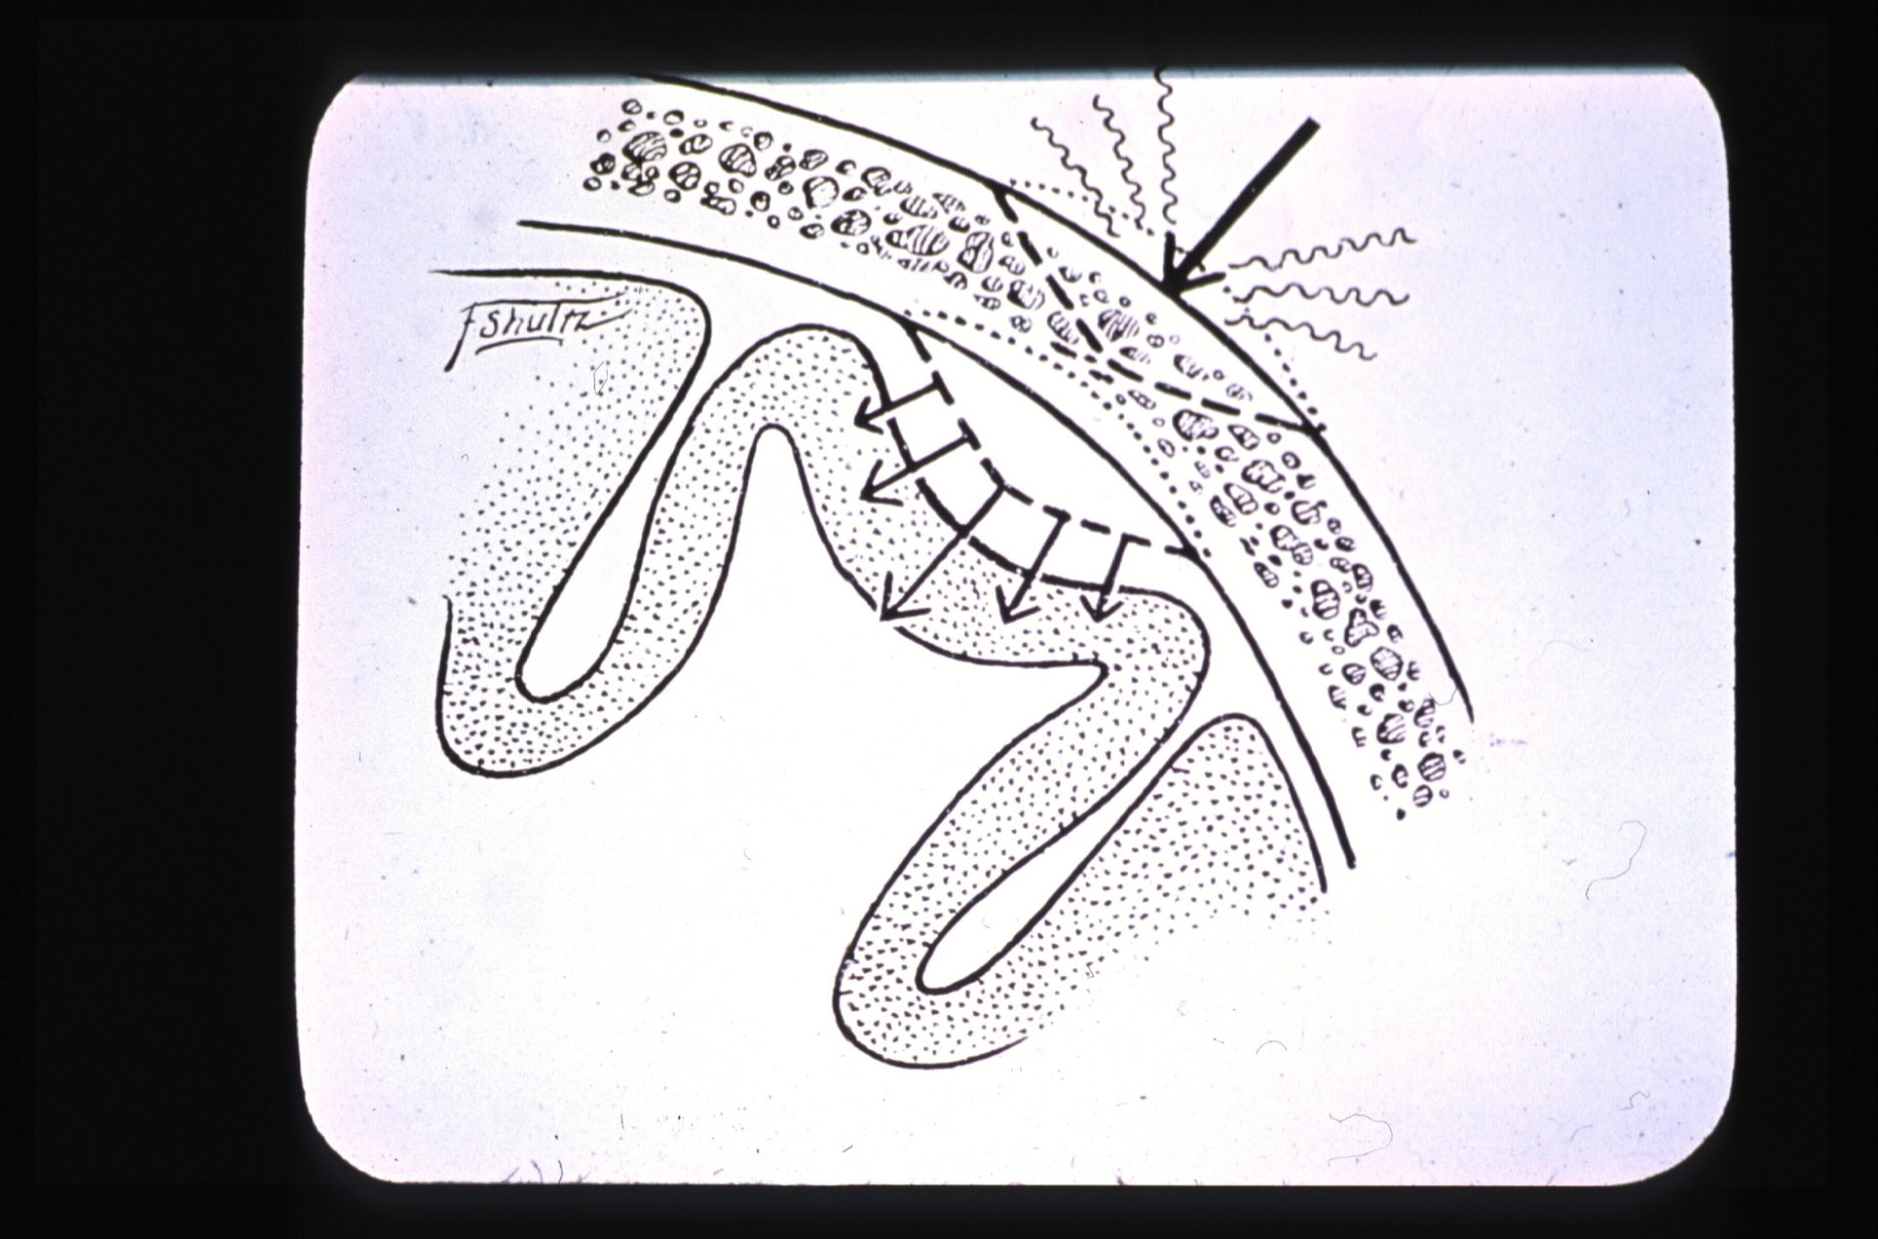
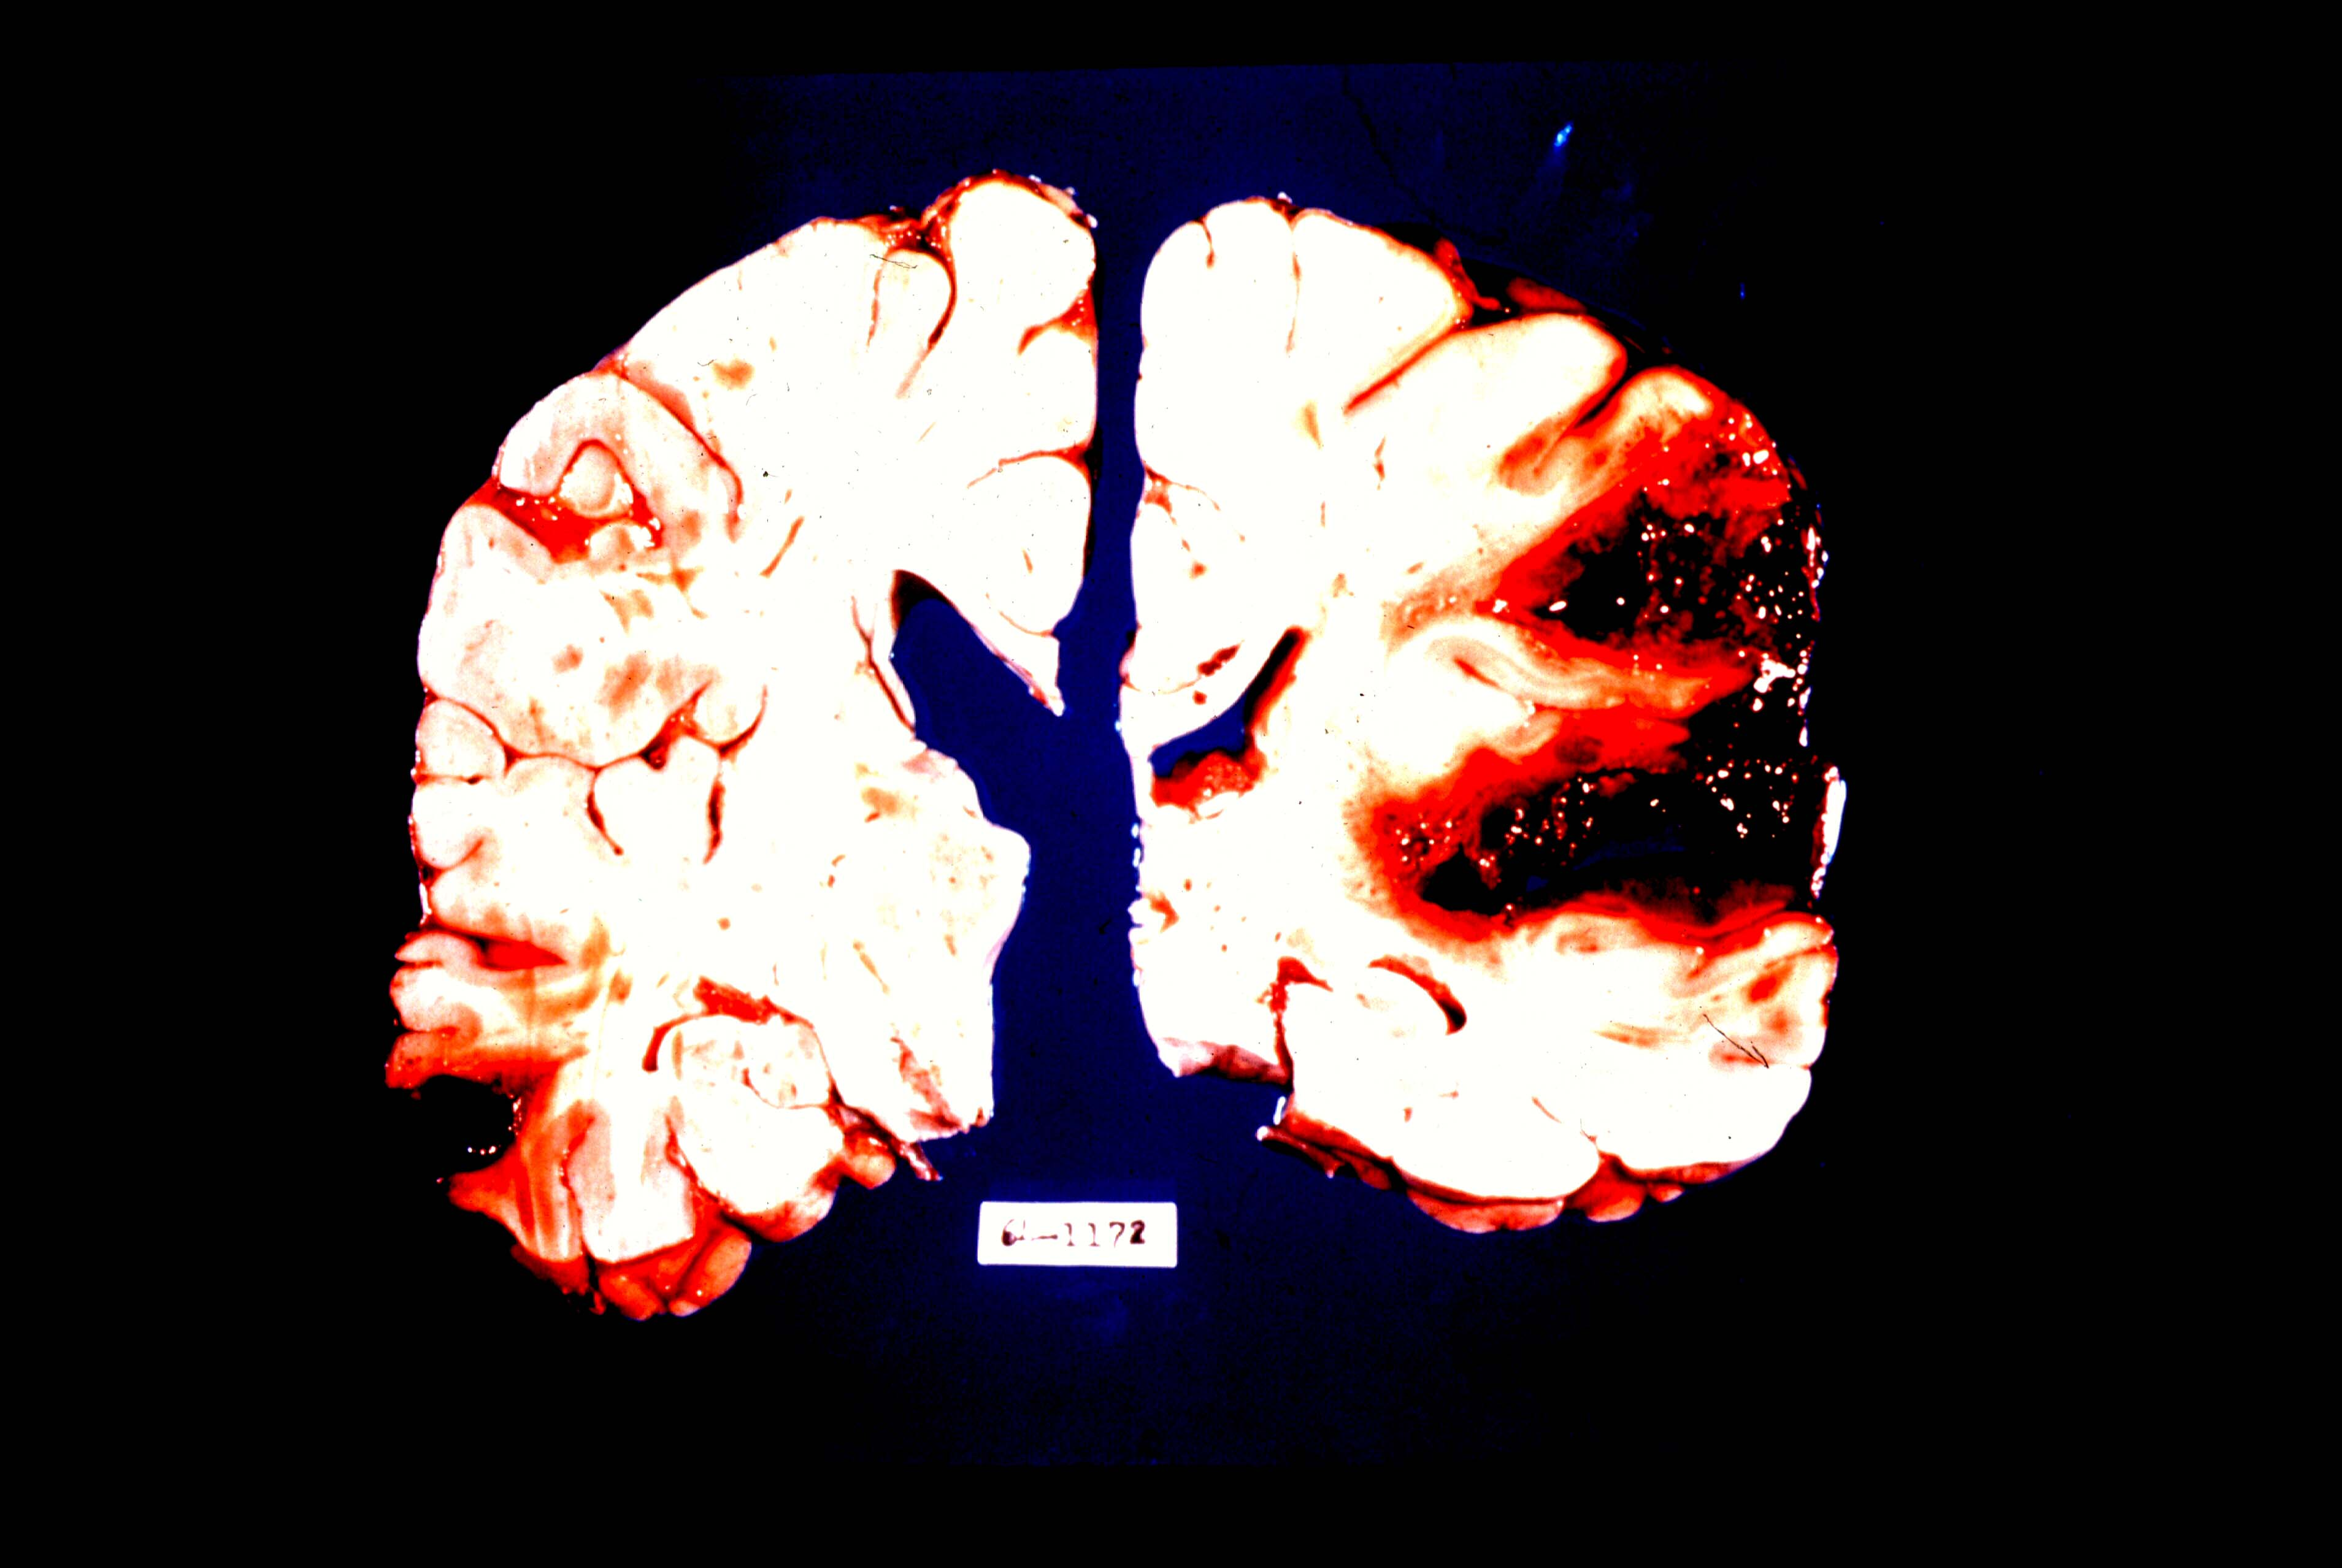
Skull Fracture and Hemorrhage

Slide 45
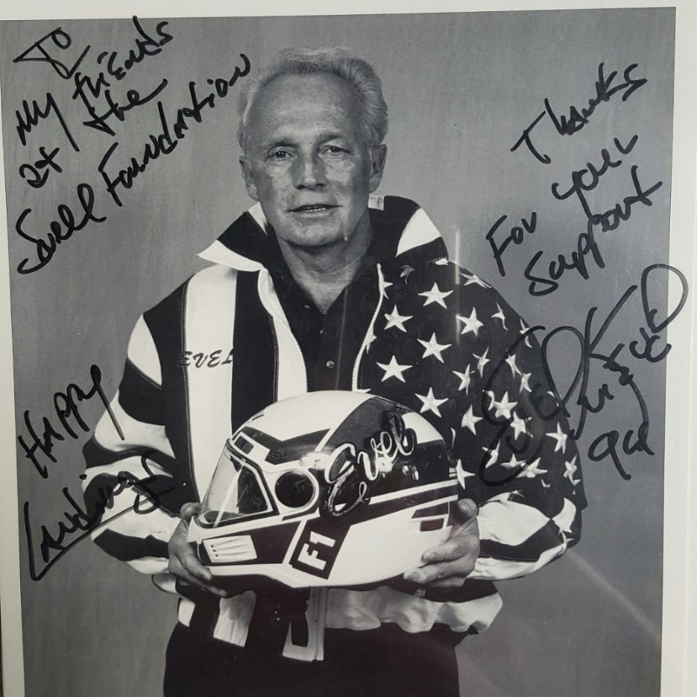
Snell Helmets Save Lives.

Slide 46
Snell Tests For Public Safety
  Snell Web Site Helmet List
  Updates Each Day
  Certified Helmets by Name and Size
  Decertified Helmets Noted

Slide 47
Snell’s Mission
Evidence based Helmet Standards
Premium Protective Helmets
Injury Prevention Education

Slide 48
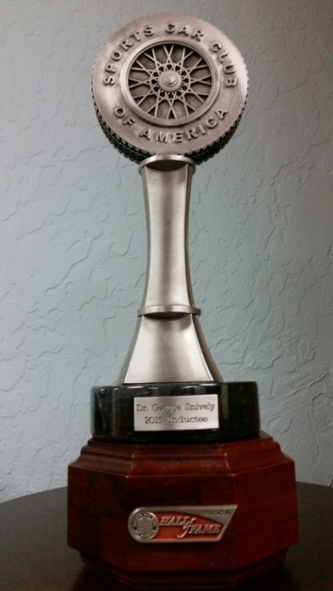
SCCA National Hall of Fame 2015

Slide 49
Helmet Dos and Don’ts
Replace every 5 years.
Fasten chin strap.
Clean with only soap and water.
Do not cut or alter the helmet liner.
Do not put helmet near hot muffler or engine.
Do not place helmet atop mirror or handle bar.

Slide 50
Snell’s Mission
Evidence Based Helmet Standards
Premium Protective Helmets
Injury Prevention Education

Slide 51

We Don’t Make Helmet.
We Make helmets Safer.

Slide 52
More Information
Videos in Snell Youtube Channel
  How Helmet Works to Protect the Brain
  Why Helmet Standards Matter
  Snell Lab Tour
  Snell Facebook/Twitter
  Call Snell Lab and Office: 916-331-5073

Slide 53
Last Words
Riders have no direct indicators of helmet protective capability
Riders can look for indirect indicators
(e.g.:a serialized Snell sticker)
There are reasonably foreseeable crashes that will exceed a helmet’s protective capabilities.
In serious crashes riders need all the impact management capability a helmet can offer.
www.smf.org 916-331-5073 for more info

