Slide 1

New Snell M2020 Standard
Premium Head Protection
Hong Zhang
SMSA
Sept. 13, 2019
Grand Rapid, Michigan

Slide 2
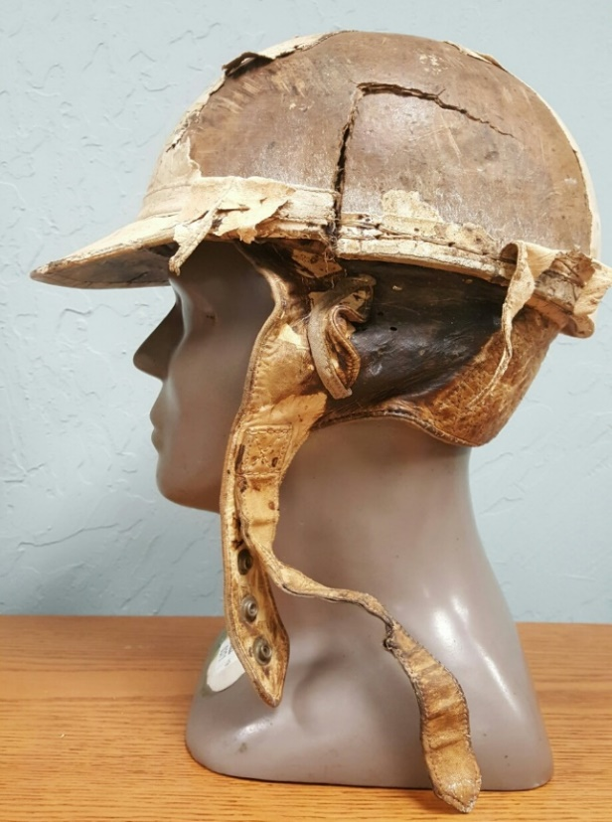
Helmet in 1950s

Slide 3
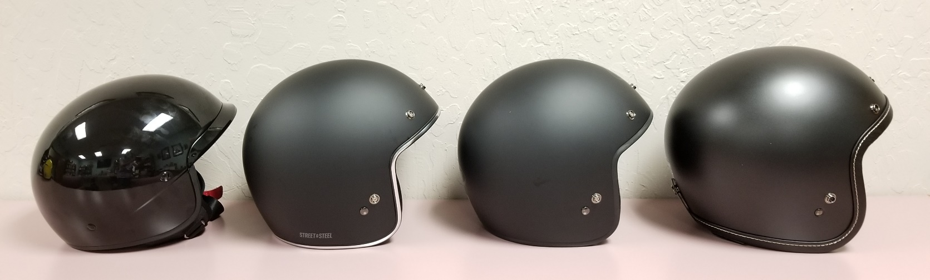
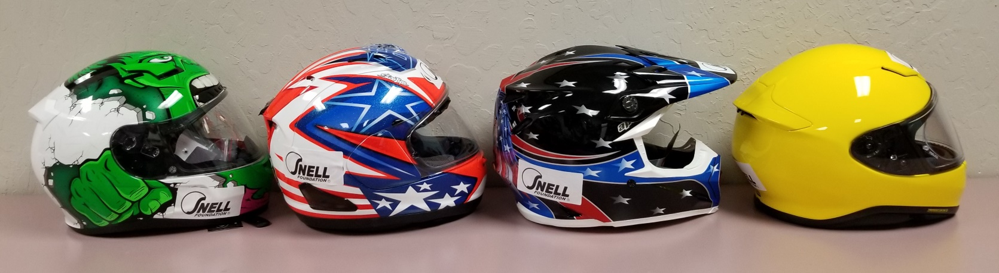
How to Choose among
Today’s Motorcycle Helmets?

Slide 4
Motorcycle Helmet Effectiveness
NHTSA estimates that motorcycle helmet usage leads to:
37% reduction of crash fatality
67% prevention of brain injuries

Slide 5
Fact Check
  DOT Standard has not changed for more protection since 1974.
  Snell Standards Update Every 5 Years.

Slide 6
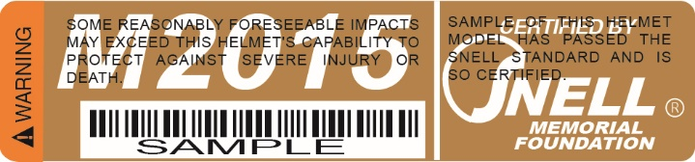
Current M2015 Standard

Slide 7
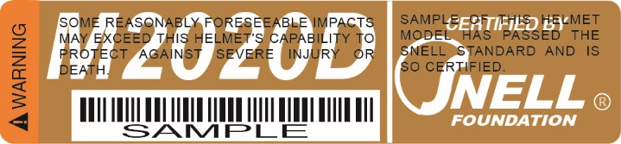
New M2020 Standard
Effective October 1, 2019

Slide 8
Newer Helmets and
Greater Protection
The effectiveness of helmet has increased from 29% between 1982-1987 to 37% between 1993-2002.(NHTSA reports)
Tougher Snell Standards
DOT Standard Unchanged
Better Designs and Materials

Slide 9
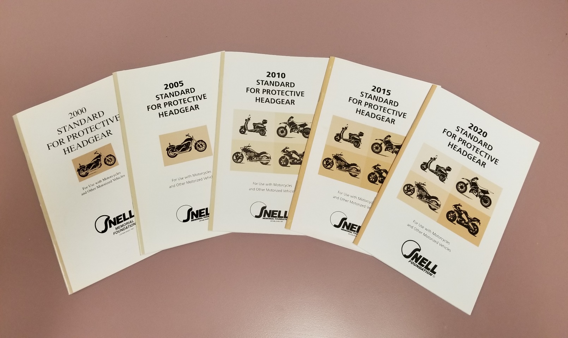
Snell Motorcycle
Helmet Standards

Slide 10
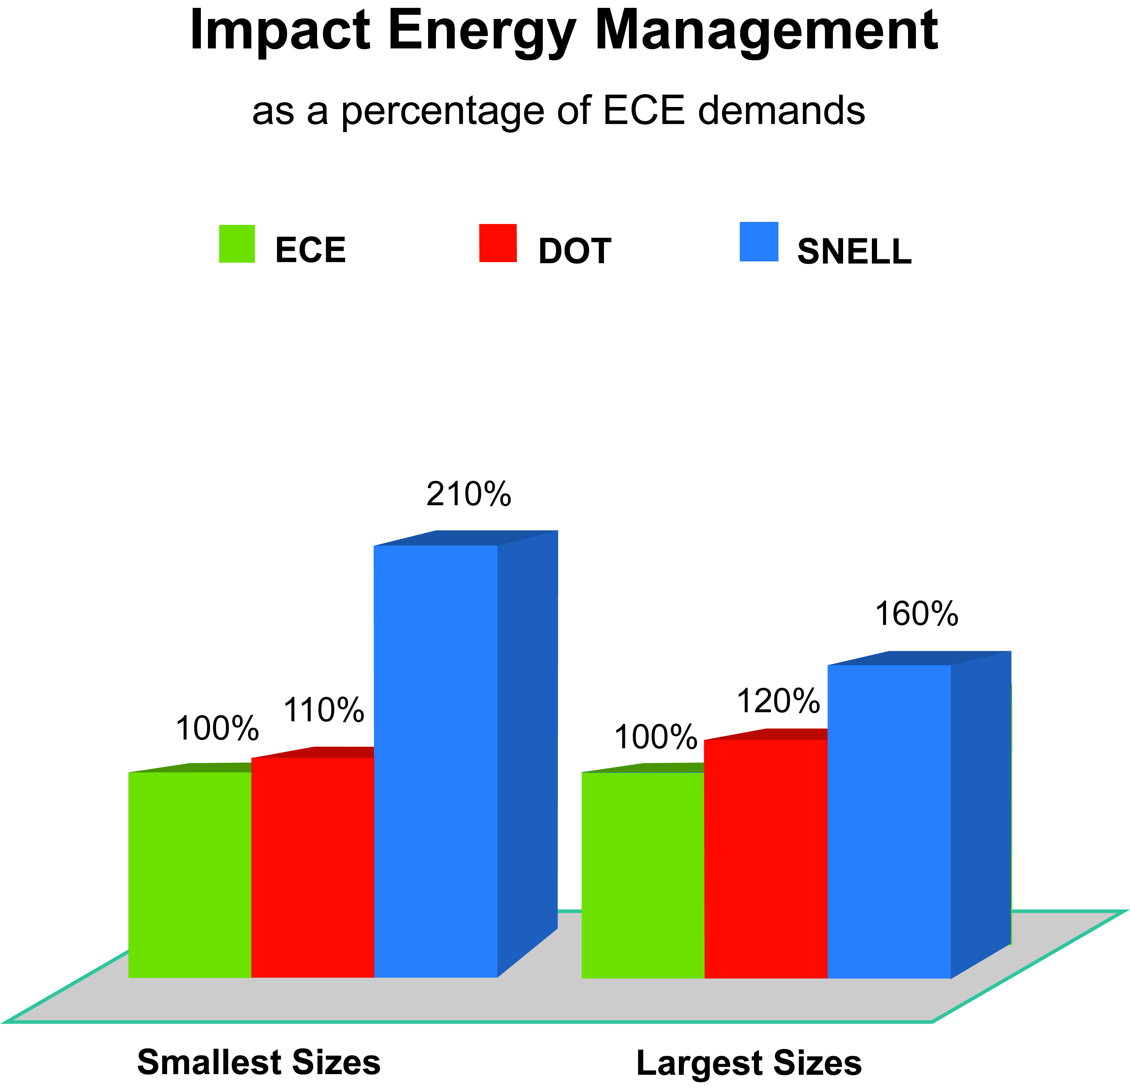

Slide 11
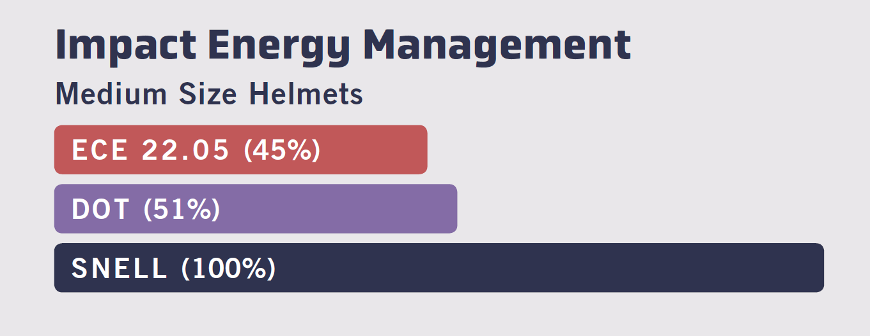
Snell Means Premium Protection.
DOT and ECE are Minimum Requirement.

Slide 12
Effectiveness of Standards
Standards = Documents
Effectiveness of standards depend on
* Strict and independent certification
* Enforceable compliance
* Experience and competence
Testing and More Testing

Slide 13
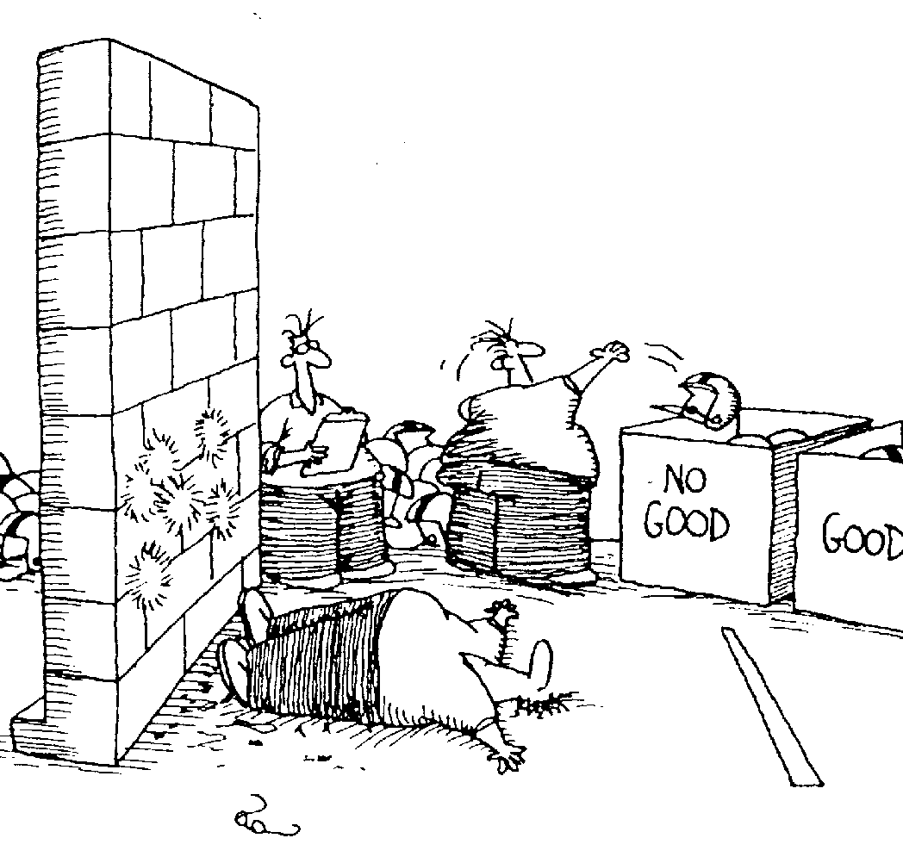
Not how Snell tests helmet

Slide 14
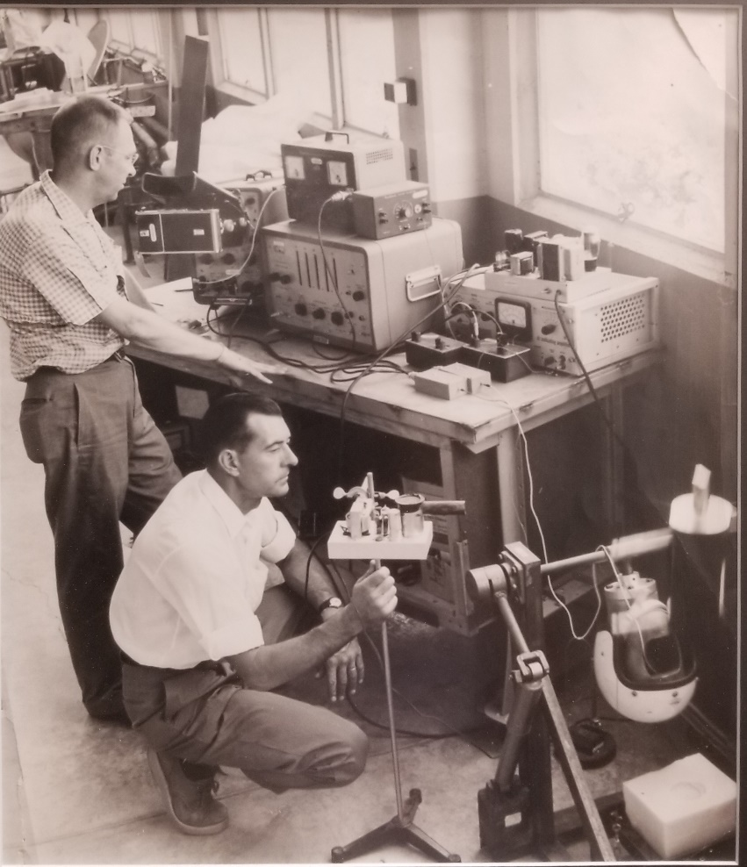
Oldest Snell Testing Photo

Slide 15
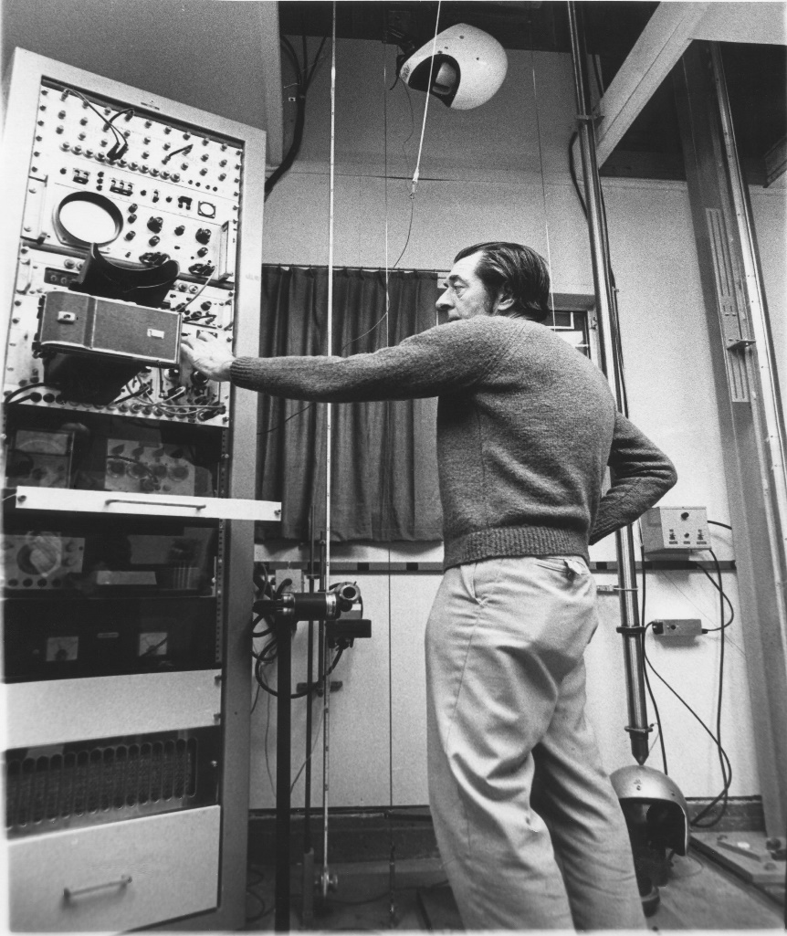
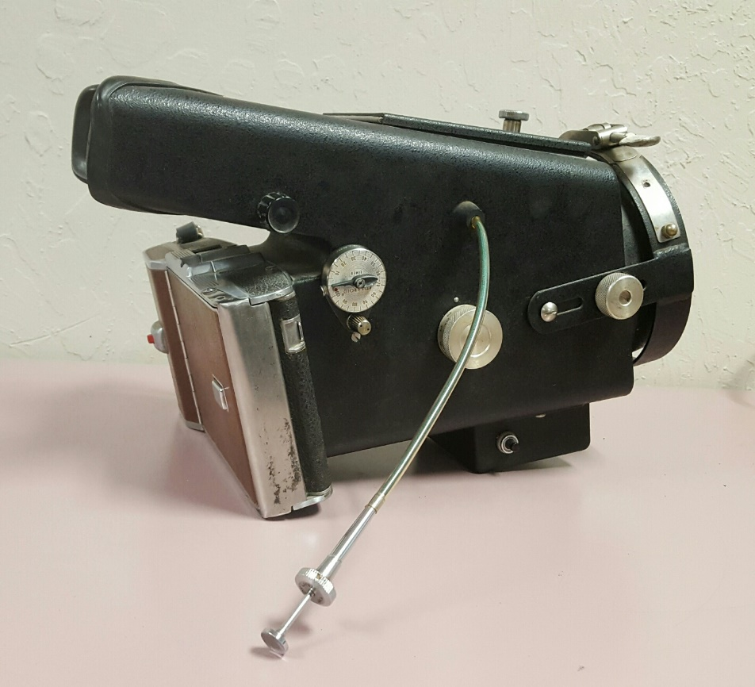
Snell Lab in Early 1960s

Slide 16
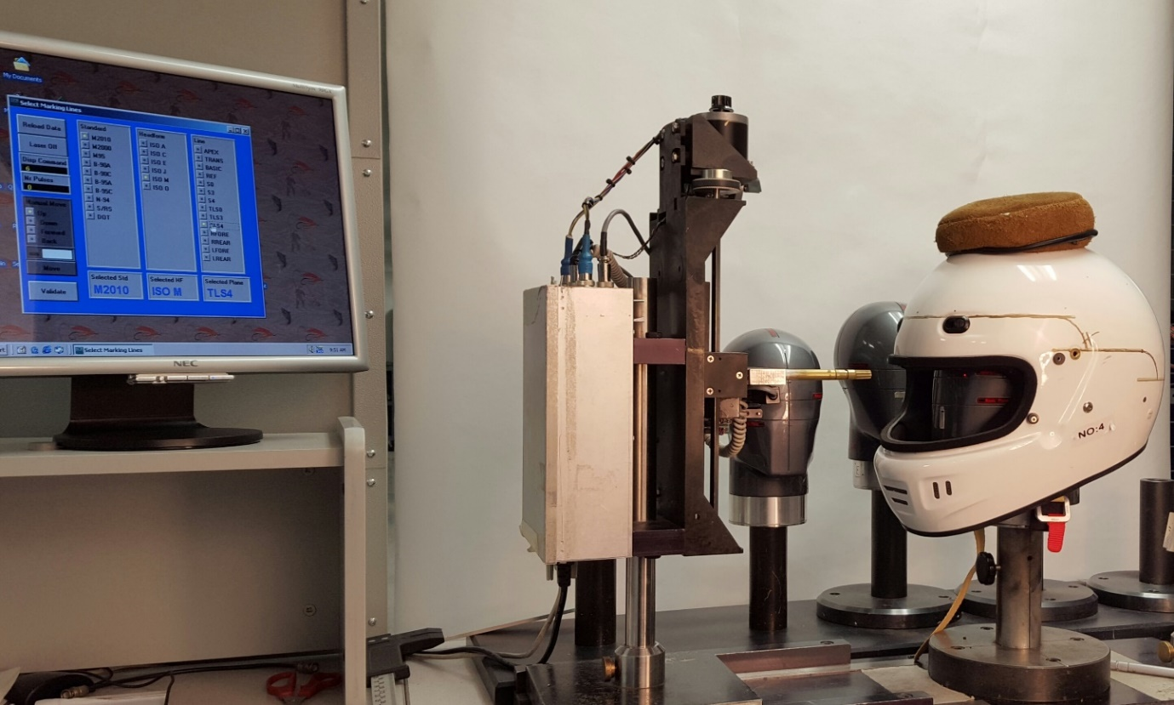
Snell Test Lab Today

Slide 17
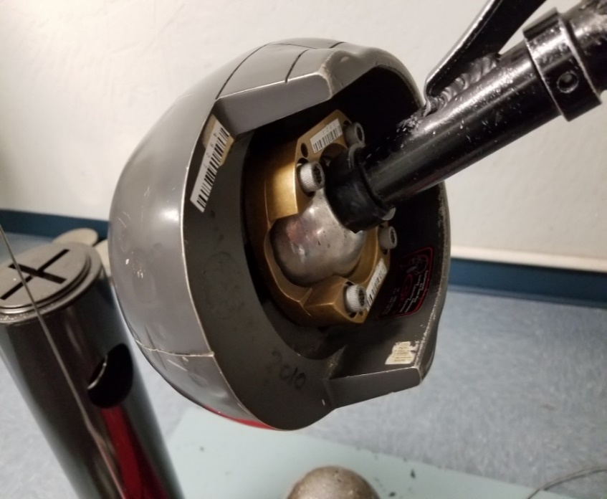
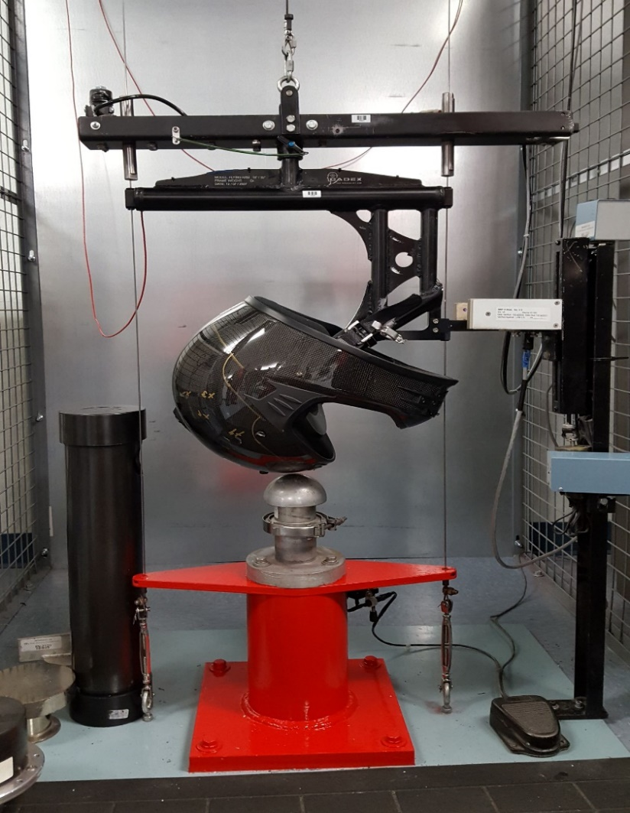
Scientifically Valid
& Repeatable Test

Slide 18
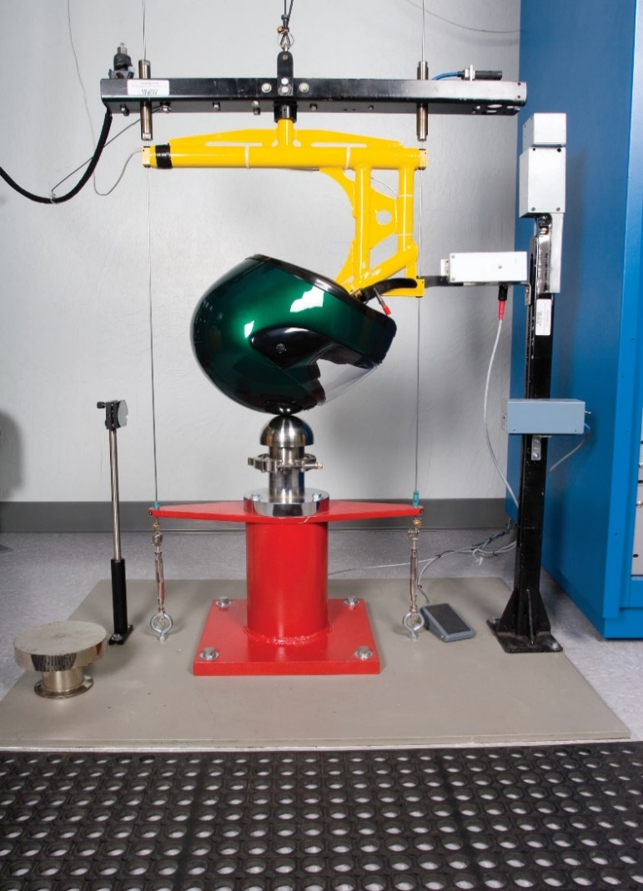
Snell Impact Test

Slide 19
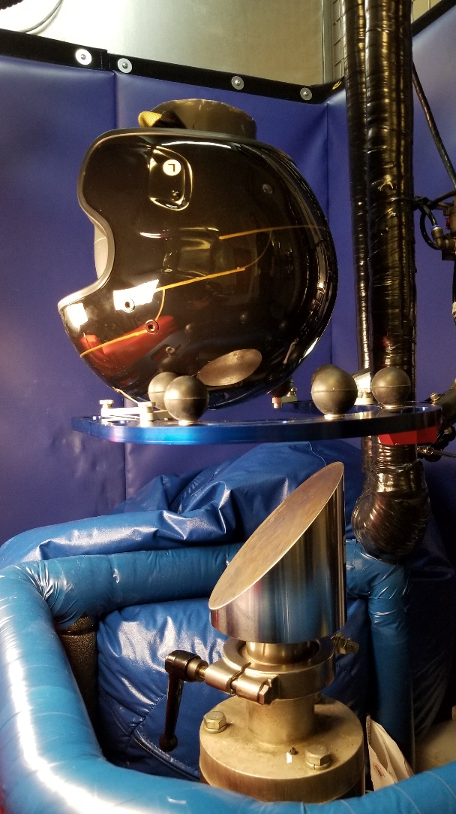
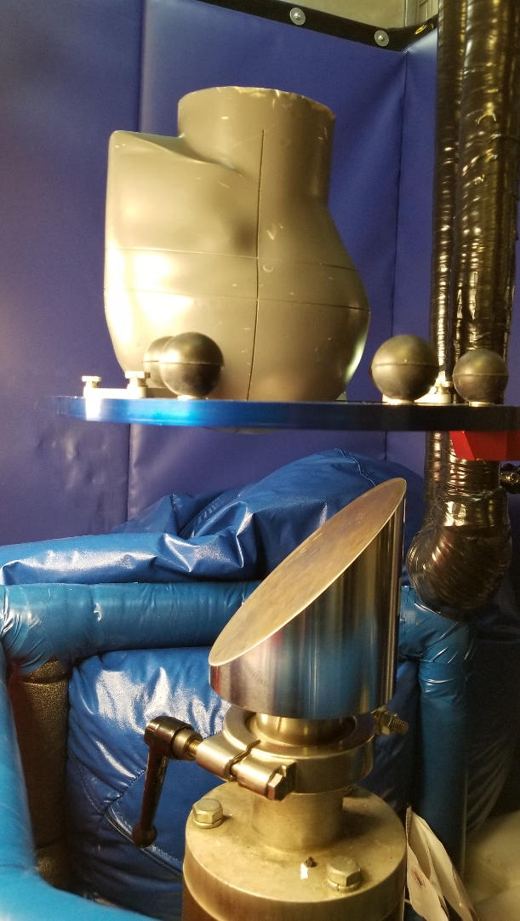
Wireless Head Form for
Rotational Impact Test

Slide 20
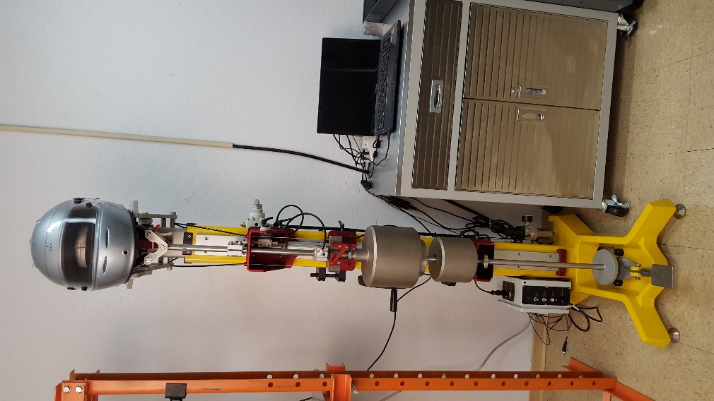
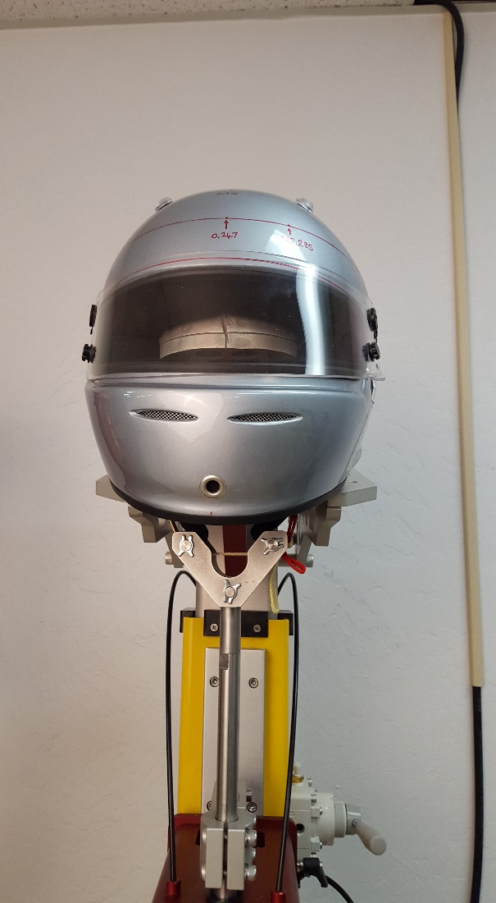
Snell Retention Test

Slide 21
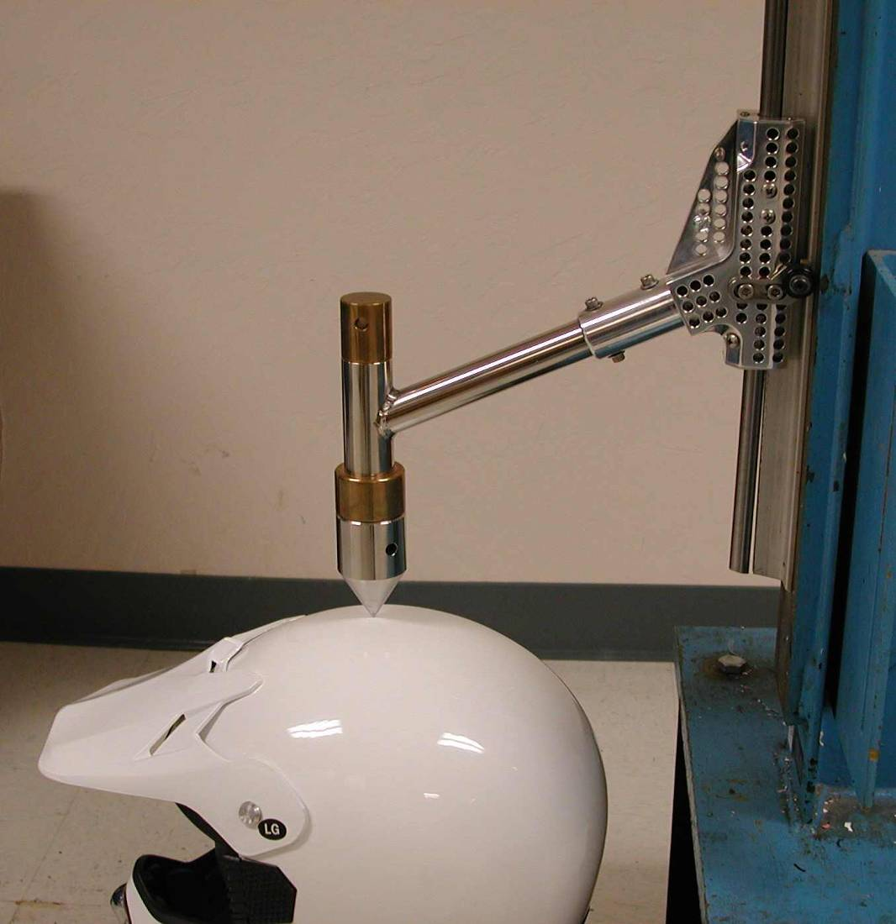
Snell Penetration Test

Slide 22
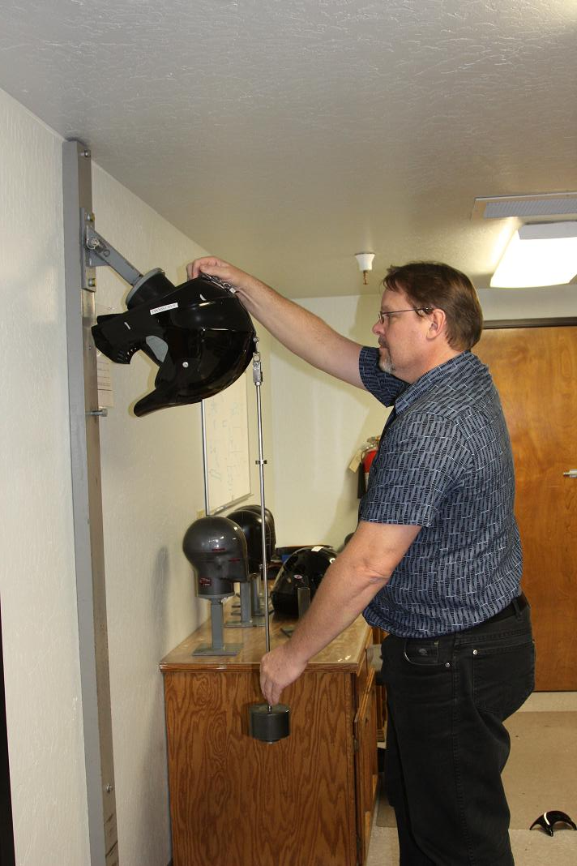
Roll-off Test

Slide 23
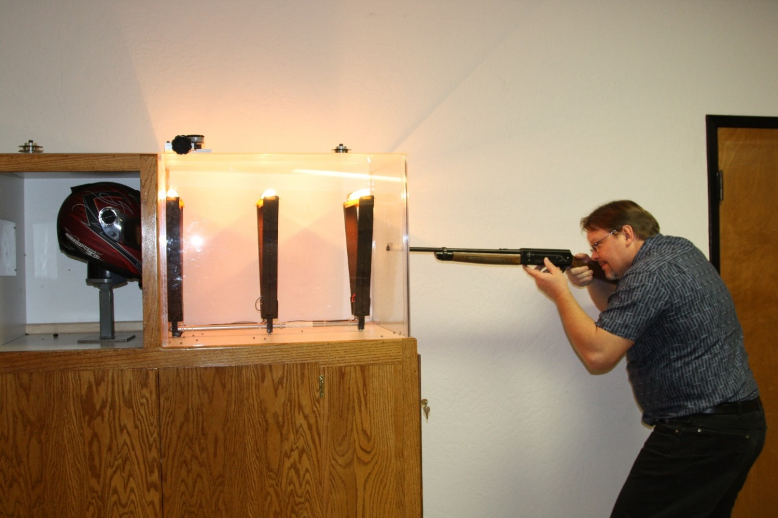
Snell Face Shield Test

Slide 24
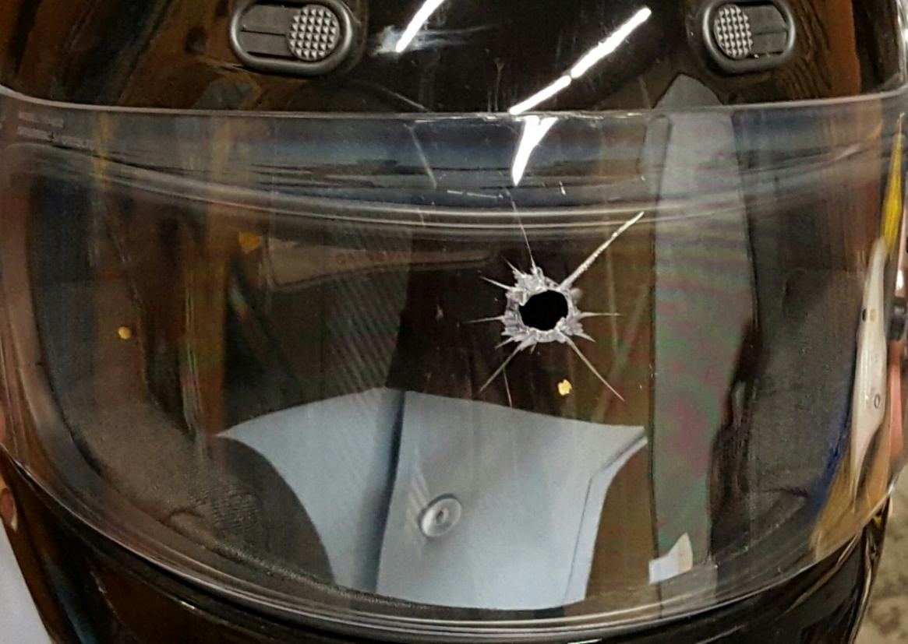
Some fail tests.

Slide 25
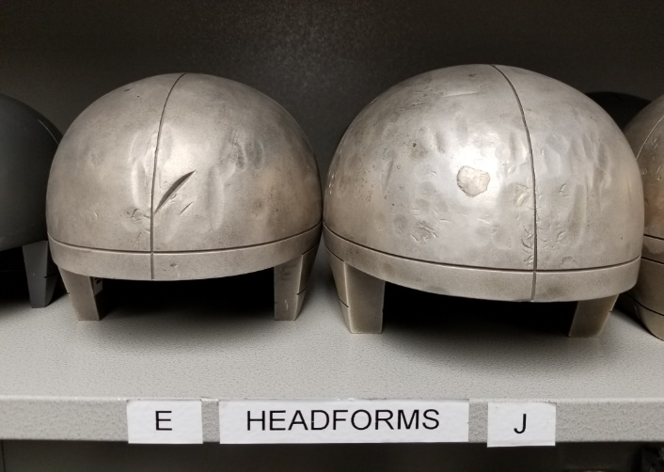
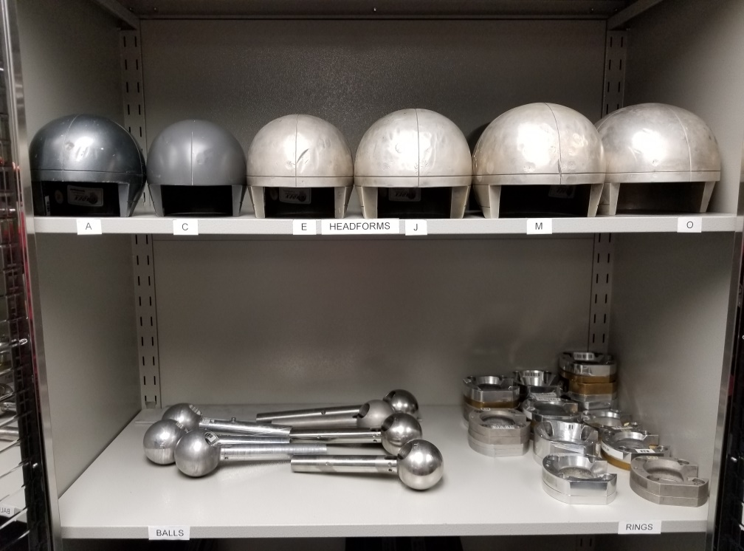
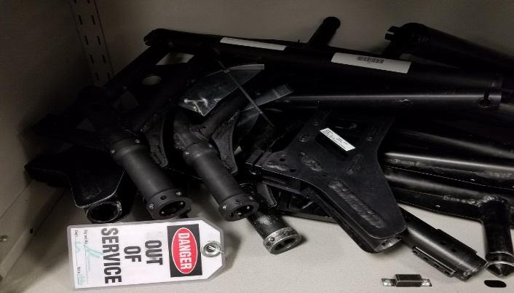
Experience and Expertise

Slide 26
Snell Tests For Public Safety
  Snell Web Site Helmet List
  Updates Each Day
  Certified Helmets by Name and Size
  Decertified Helmets Noted

Slide 27
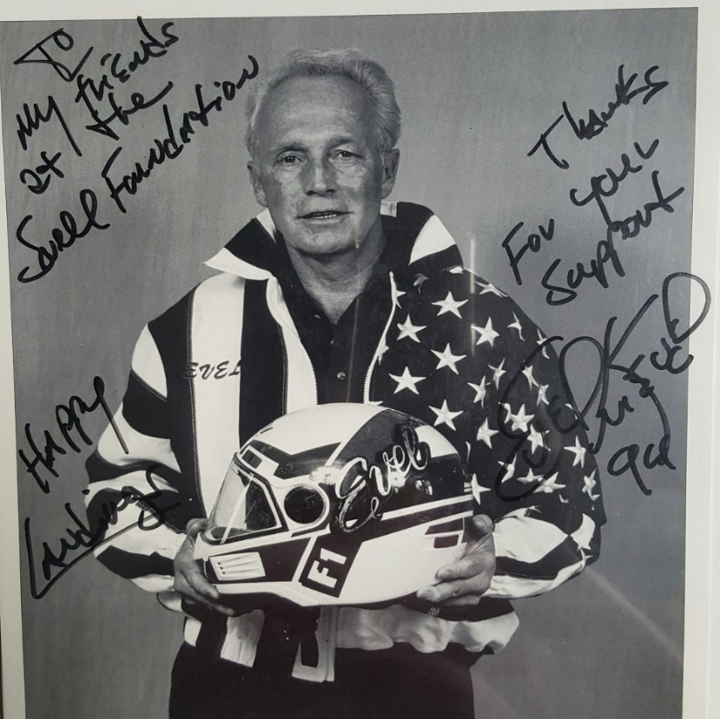
Snell Helmets Save Lives.

Slide 28
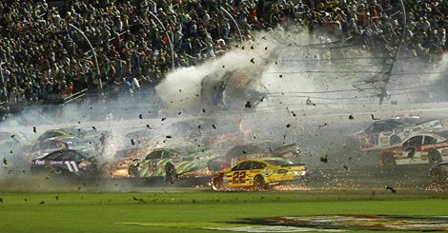
Austin Dillon Walking Away from
2015 Crash NASCAR Daytona Finish

Slide 29
Helmet Fit Research
Well-fitted helmets protect better.
Dr. Amy McIntosh reported in 2012 that children with help fitting a helmet had concussions reduced by 41%.

Slide 30
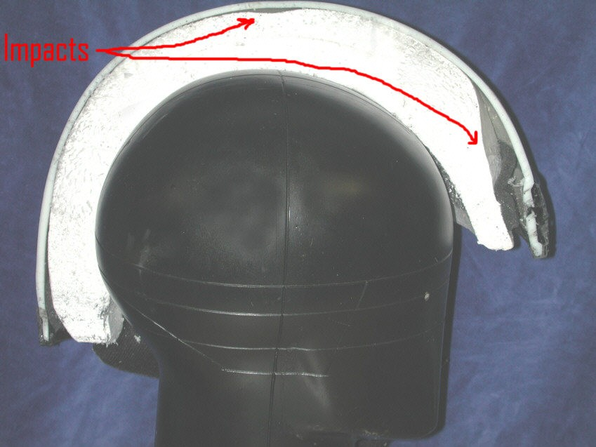
Shell Spreads the Load.
Liner Foam = More Braking Time
Notes:
This is an example of what impact can do. This is a tested helmet which was sawn in half. You can see what test impacts have done in the front. The shell has recovered but the stiff liner has been permanently crushed. It has actually recovered some of it’s thickness. During the impacts, it was squeezed much thinner. Snell helmets need every bit of their wall thickness to pass the tests. Of course, a smaller hit wouldn’t require as thick a liner but if that thinner walled helmet was to get a major hit, once the liner was used up the rest of the damage would go to destroying our test head form; or some rider’s head.

Slide 31
Snell’s Mission
Evidence Based Helmet Standards
Premium Protective Helmets
Injury Prevention Education

Slide 32

We Don’t Make Helmet.
We Make helmets Safer.

Slide 33
Helmet Dos and Don’ts
Replace every 5 years.
Fasten chin strap.
Clean with only soap and water.
Do not cut or alter the helmet liner.
Do not put helmet near hot muffler or engine.
Do not place helmet atop mirror or handle bar.

Slide 34
More Information
Videos in Snell Youtube Channel
  How Helmet Works to Protect the Brain
  Why Helmet Standards Matter
  Snell Lab Tour
  Snell Facebook/Twitter
  Call Snell Lab and Office: 916-331-5073

Slide 35
Last Words
Riders have no direct indicators of helmet protective capability
Riders can look for indirect indicators
(e.g.:a serialized Snell sticker)
There are reasonably foreseeable crashes that will exceed a helmet’s protective capabilities.
In serious crashes riders need all the impact management capability a helmet can offer.
www.smf.org 916-331-5073 for more info

